Slide 1
VISUAL MAPPING AND NAVIGATION
DATA SCIENCE
Demo
Autonomous navigation without GPS and vehicle telemetry

Slide 2
Executive summary
Today the navigation activities take a huge part probably during any trip and sometimes requires many (paid) artefacts/applications and devices. But let’s imagine the driver that drives somewhere many times a day/week (way to work, etc.)…
Driver with regular routes can drive without using the additional equipment, GPS, pre-installed maps, voice helper or road rules. How he is doing that – it is mostly obvious – he is driving using his knowledge about the road, street view, traffic lights, etc. So the navigation looks like – ‘so I’m near the white sign pharmacy, to get to work I need to pass the red brick house, turn to the left and drive past two white houses, a traffic light and there at the end will be my job - a green glass business center’. Our case here – to try simulate such activity, add such navigation confidence for any driver in previously unknown environment using modern Deep Learning methods and other Data Science possibilities

Slide 3
Open questions
What is the quality of in-car field of view? Obviously we can use on-dash camera, but then the model should understand the cameras specifications variance.
Where to get the streets/roads pattern knowledge?
There are many street images or even raw tourist photos with tags (street name, cords, etc.) on the web that are allowed to use in academic purposes.
How to compare in-car FOV and known environment? We can use some static objects that can be similar during years (buildings, etc.)
What is the acceptable accuracy and algorithm speed? This depends on the camera, lightning, car speed, noise and environment changes (signs, trees, etc.). Can be increased using more images also from different seasons/years, also requires more powerful hardware.

Slide 4
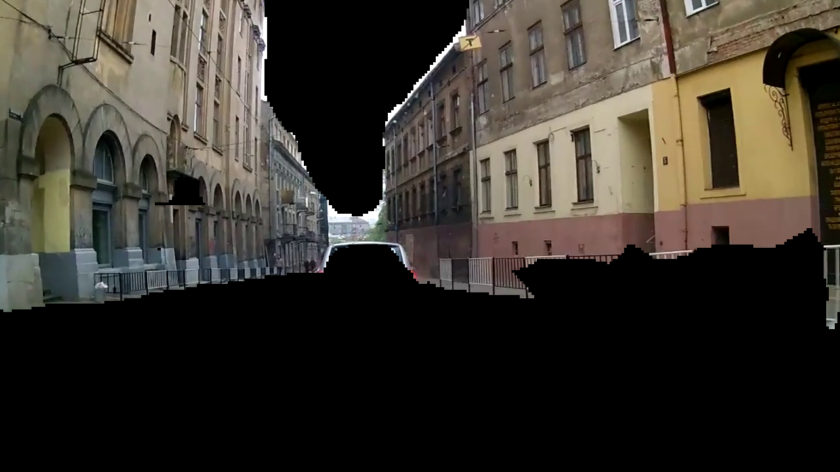
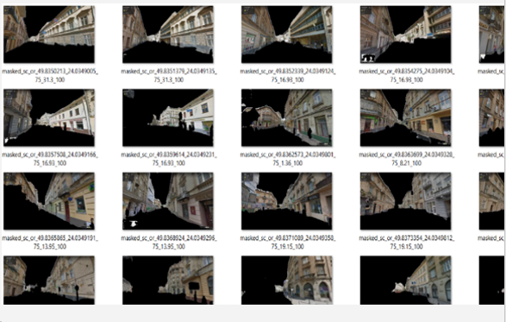
Image segmentation task
Dataset Cityscapes 19 classes (focus on buildings, road, signs, etc.)
Models Here we are using the already trained model from deeplab based on xception inference (there are many others, faster and with different map/iou). Final layers are the semantic probabilities (mostly dim ~ classes*output_image_dims (without channels)), so they can be filtered and become the inference to similarity model (recommended to transform they to embedding layer or find more suitable layer before the outputs, also with the object features it includes the location etc., that can bring unnecessarily noise).

Slide 5
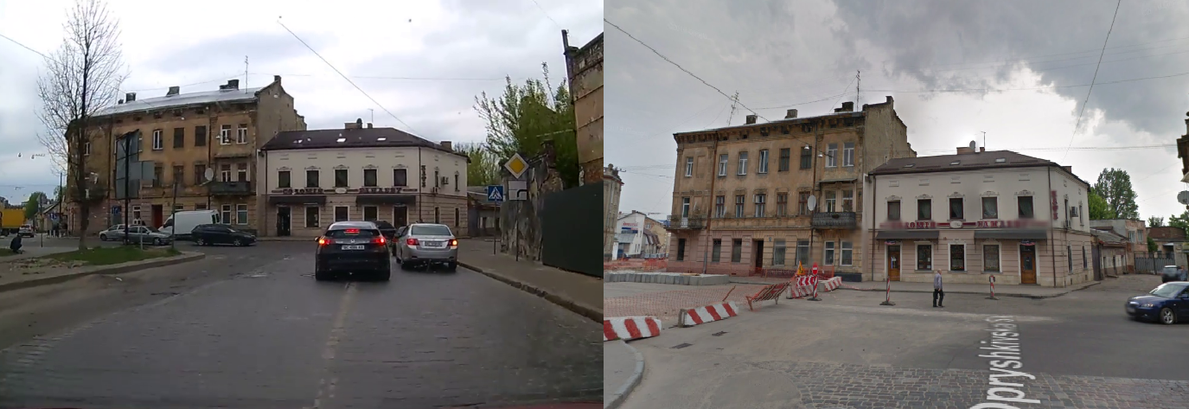
Additional data gathering and labelling
Downloaded the raw photos from the web for the streets/roads names/cords. Got the street API key for download
Labeled in semi-automated way based on the names/locations, verify manually. Then created the images pairs for the similarity model training.
Finally, with the augmentation (also adding different time/seasons photos) and labeling using model (for e.g. additional not similar class for images that the model predict as similar, but one is far from another). Approx dataset size – 8-12K with augmented images.

Slide 6
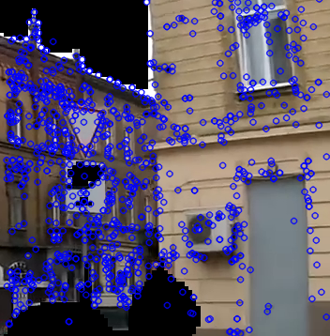
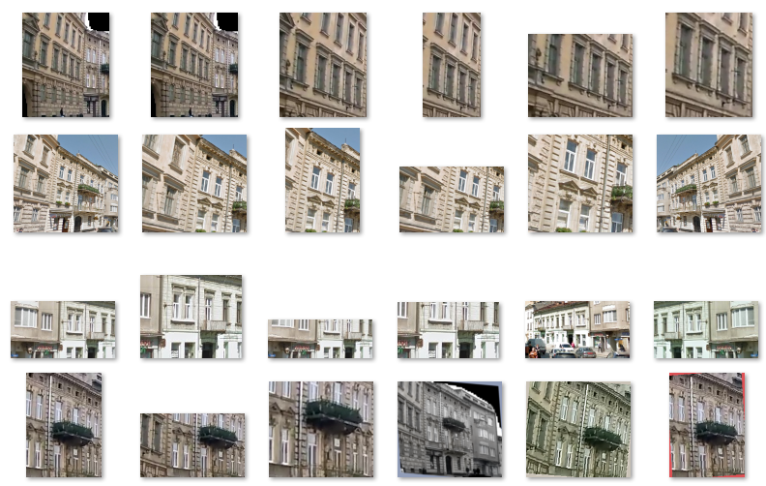
Similarity models ideation and validation
We tested few street/road view comparison approaches from classical descriptor/template matching to modern SOTA DL algorithms (for e.g. QATM)
Final and most accurate was the inference model (representation for each segmented image in pair, backbone - VGG || ResNet || efficientNet) + binary classifier (xgb || rf). Validated accuracy mean (overfitted for Lviv most frequent/popular streets, 2011-2019 years and with augmentation) – ~ 82.5% .

Slide 7
Assumptions and performance features
We segmented every 10th frame – it is helpful for the near real-time calculation. Also, there cant be huge changes In environment in 10 frames (1/3 s).
DeepLab models >70 mIoU (cityscapes, third semantic mat - buildings), time for prediction (CPU 5s-more than 10m (xception based), GPU – <1-5s (from article, not tested))
Similarity prediction, ~ 1m per 100 pairs (inference on GPU (4Gb VRAM) + classifier on 6 CPU cores)
Can be optimized after first estimated positions – to limit search only to closer street views (the vehicle can’t appear more than 1 km in 10-50 frames).
The city wasn’t cover with all streets, so we found the videos with city centre driving
As the map positioning we used wiki maps (but can be switched to any other), the vehicle coords were got from the street view meta data (lat/long, street name).
For some streets segments there are few examples (like the same location in 2011 and 2015, photos from different sources, etc.), so the classifier should find any of them.
For the streets augmentation we used mostly weak affine transformations, but not flipping or strong colour/shapes changes.
Some of the estimations can be wrong due to different reason:
street/road estimation – the static object area is low, on the street there is much noise (vehicles, pedestrians) or seasonality changes (trees, snow, rain, etc.);
vehicle position and speed errors – the same street position (+ diff street step, euclidian dist for curved streets) can be viewed with different focus (distance to object), etc.

Slide 8
Finalization
Rendered video sample of the navigation (not real time and with post processing)
segmented video frame
last found similar street/road
estimated vehicle position based on the found street
in-car video
continuous similar street search
log (counter, coordinates, speed, etc.)
Video sample
Video sample

Slide 9
THANK YOU Q&A
Data Science

