Slide 1

PREDICTABLE MARKETING.
HOW TO MANAGE ROI OF YOUR MEDIA INVESTMENT

Slide 2



OMD Media Direction Ukraine
IN UKRAINE
IN THE WORLD
65 COUNTRIES
85 CITYS
5,000+ EXPERTS
$16 BILLIONS OF BILLING
EMEA
NO.1
THE MOST EFFECTIVE IN
2012-2017
TOP10
AGENCY IN EUROPE
in 2017
NORTH
AMERICA
2 COUNTRIES
7 CITYS
1,900+ EXPERTS
$18.5 BILLIONS OF BILLING
#11
АТР
MEDIA
AGENCY
18 COUNTRIES
18 CITYS
800+ EXPERTS
$1 BILLIONS OF BILLING
17 COUNTRIES
29 CITYS
1,800+ EXPERTS
$5.5 BILLIONS OF BILLING
LATIN
AMERICA
BY BILLINGS

Slide 3

OMD Intelligence: development and implementation of data-based solutions in the marketing and communications
MEDIA RESEARCH
MARKETING STUDIES AND CONSUMER INSIGHTS
BUSINESS ANALITICS AND DATA-DRIVEN STUDIES
  market review / competitor review / quantitative and qualitative strategic analysis
  market and category research / consumer behavior research / Snapshots
  Brand Metrics ®

Slide 4

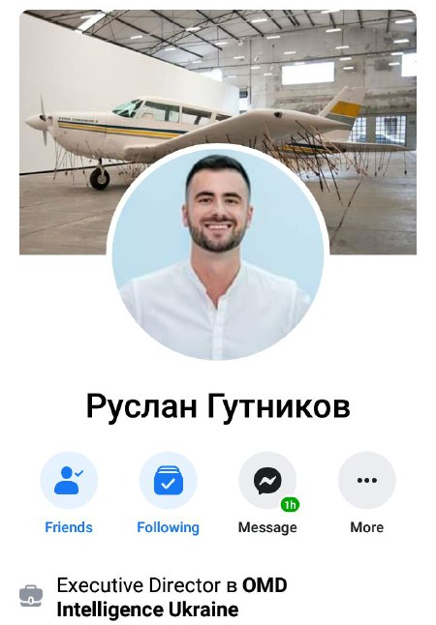
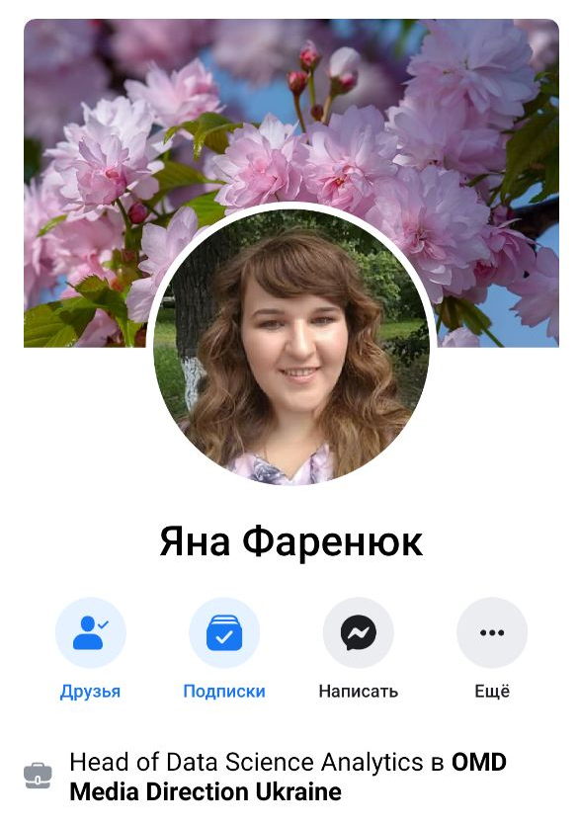
Ruslan Gutnikov
Yana Fareniuk
Notes:
cli

Slide 5

Since 2011 we have gained experience in all key market categories
Brand Metrics ® is a range of services that provides opportunities for more effective control and forecasting the process of achieving business goals and consequently allows you to more confidently and effectively invest in brand development
FMCG
E-MARKETING
PRODUCT RETAIL
PHARMACY
FINANCE / BANKS
TELCO
Notes:
Brand Metrics ® – это комплекс услуг по бизнес аналитике, который нацелен на построение модели прогнозирования ключевых бизнес метрик, контроля их выполнения и управление ключевыми маркетинговыми факторами влияния

Slide 6

ADVERTISING = INVESTMENT calculate ROМI (Return of Marketing Investments) and create new rules for media placement
DATA DRIVEN PLANNING
CLASSIC MEDIA APPROACH
Applications
number of
Conversion
the ratio of applications and sales
Sales
unique sales
Share of voice
share of presence against competitors
Frequency
frequency of contact with the consumer
Coverage
target audience coverage

Slide 7
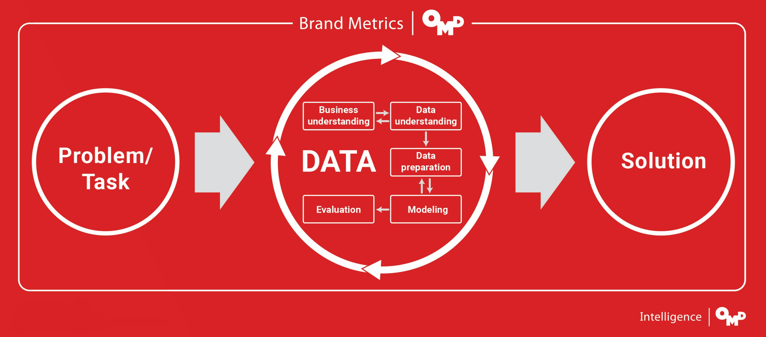

Slide 8

RESULT - SCENARIO FORECASTING AND BUSINESS SIMULATION
        For example:
        - What will happen if we transfer the budget for TV activity to work with doctors and pharmacists?
        - What will happen if we grow TV support by X%?
        - What happens if we raise prices by X% and increase the work with doctors and pharmacists by Y%?
Notes:
СЦЕНАРНОЕ ПРОГНОЗИРОВАНИЕ И БИЗНЕС-СИМУЛЯЦИИ
Например:
Что будет, если мы перенесем бюджет на ТВ активность в работу с врачами и фармацевтами
Что будет, если мы усилим ТВ поддержку на Х%
Что будет, если мы поднимем цены на Х% и усилим работу с врачами и фармацевтами на Y%

Slide 9






Data collection and preparation is one of the key steps
CLIENT DATA
OPEN DATA:
MEDIA MARKET RESEARCH
SOCIO-ECONOMIC INDICATORS OF DEVELOPMENT OF THE COUNTRY AND COMPETITIVE ENVIRONMENT
Calls / Traffic
Target Calls / Target Traffic
Applications
Sales
Qualitative data on the specifics of the business
Target Audience Research
Sales volume of each product form (in money and in packages)
Price policy
Distribution / penetration
Recommendations of doctors and pharmacists
Exchange Rate / GDP / Inflation
Employment / Real Salary
Trends in the development of a business category in Ukraine.
Characteristics of business and competitor products
Consumer Sentiment Index
The financial situation of Ukrainians
Media activity and consumer analysis:
Historical data on media activity of the client and its competitors in all communication channels
- TV
- Outdoor advertising
- Radio
- Internet
- Press
Audience profile and use of various media

Slide 10
CASE STUDIES
BRAND METRICS ®

Slide 11
case 1
ANALYSIS OF SALES FACTORS AND
FORMING AN EFFECTIVE MEDIA STRATEGY
PHARMACY

Slide 12
Determine all the factors that have impact on sales
Base level (combination of rational and marketing factors)
Penetration
Price policy (Price Index)
SALES
Doctors Recommendations
Pharmacist recommendations
Media activity of competitors by communication channels / creatives / ...
Media activity of our brand by communication channels / creatives / ...

Slide 13
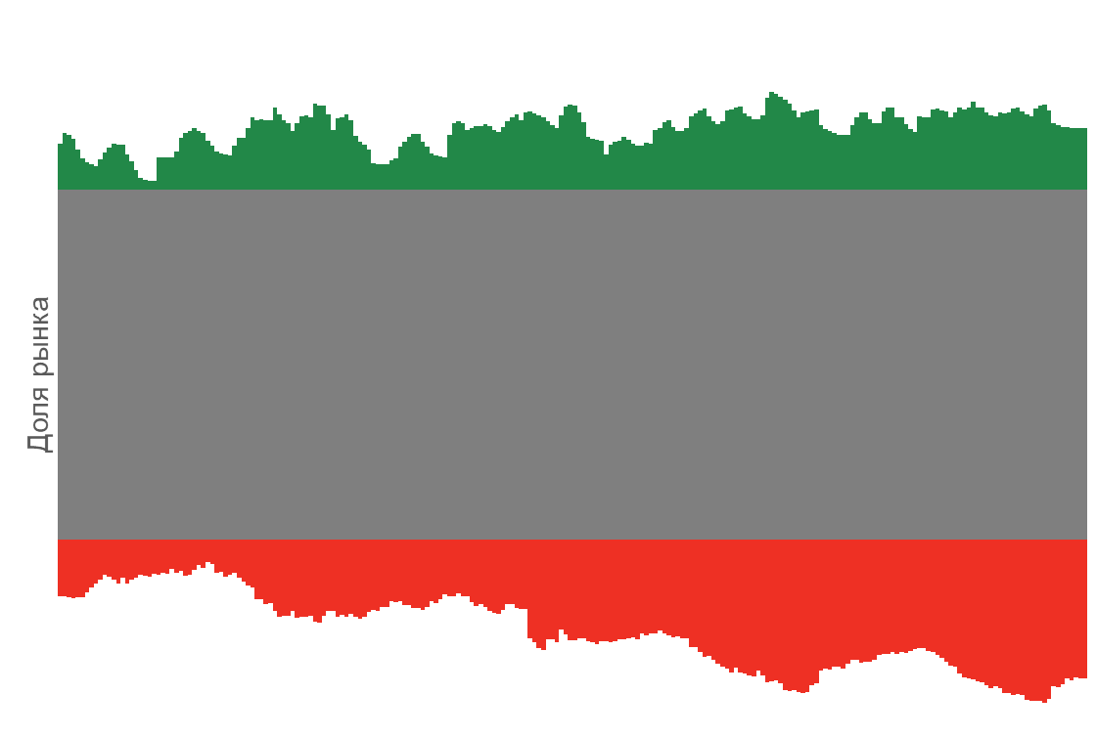
Base level the basic level may provides about ~ 57% for brands and it depends on the brands history on the market
Basic sales include:
minimum penetration level (for the analyzed period)
minimum price index (for the analyzed period)
minimum level of work with doctors and pharmacists
brand awareness
product image (effectiveness for the consumer)
previous product consumption experience
other factors that cannot be estimated within the model
Market share

Slide 14
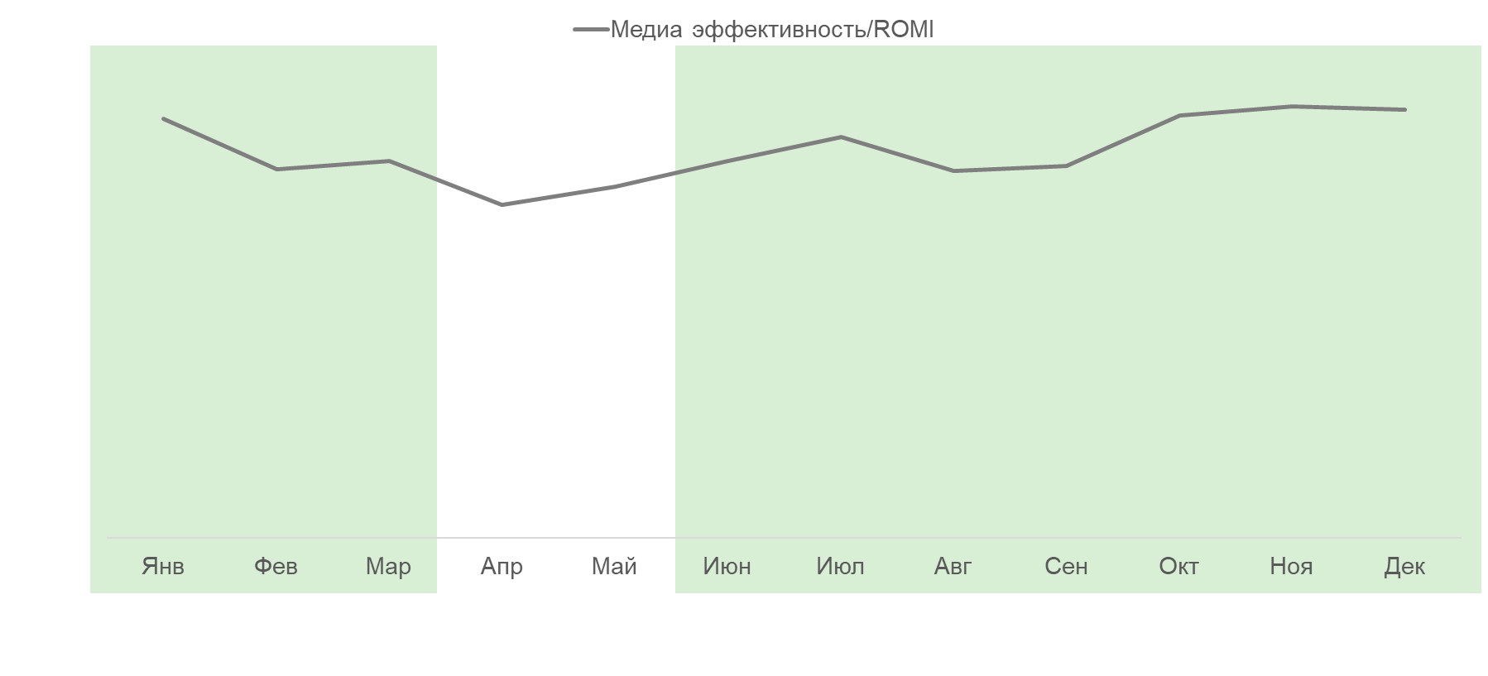
Result for the media - understanding ROMI for each brand in the portfolio and for each period
ROMI level
Jan | Feb | Mar | Apr | May | Jun | Jul | Aug | Sep | Oct | Nov | Dec

Slide 15
case 2
ADVERTISING CAMPAIGN EFFECTIVNESS
PHARMACY

Slide 16
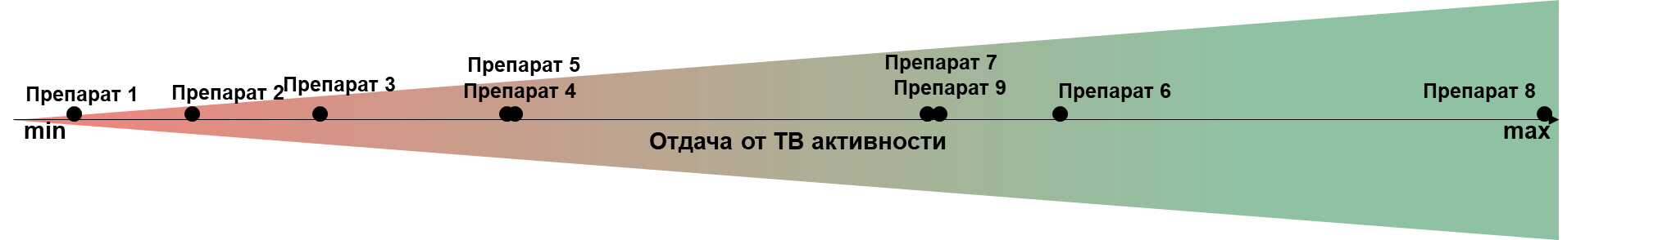


ROMI for TV is not the same for each brand in one category
The effectiveness of an advertising campaign depends on the following factors:
Level of penetration
Objective: to find and optimize all factors that determine the effectiveness of an advertising campaign
Rice (Price Index)
Media weight (AWW) and number of competitors
Quality of the creative materials

Slide 17
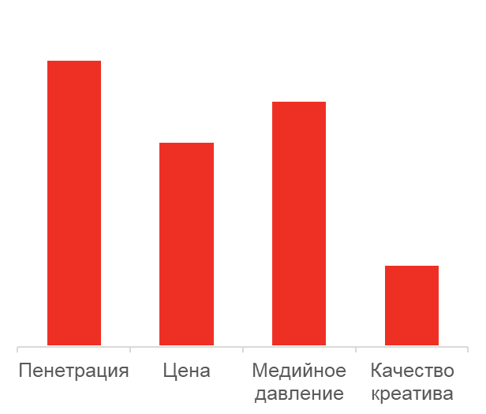

Factors
Impact
Optimization
Level of penetration
There is potential for optimizing each factor individually
Price (Price Index)
Media weight (AWW) and number of competitors
Quality of the creative materials
Price
TV
Quality of the creative
materials
Penetration

Slide 18
case 3
PRICE SENSITIVITY AND PRICE ELASTICITY
PHARMACY / FMCG

Slide 19
How to work with marketing mix
DATA DRIVEN PLANNING
Product
Promotion
Price elasticity definition
Best Price Index Recommendations
Distribution level recommendation
Sales forecast at planned price and / or distribution level
Place
Price

Slide 20




Price Sensitivity Analysis Methodology
A series of regressions was built for each brand. Use data on sales, price, distribution and activity on TV
All data were combined into one analytical pool
The price elasticity level was calculated on the basis of two previous steps: when this level is exceeded - the price of the product becomes the main factor affecting the choice of consumers
All brands classification
Notes:
1. Построена серия регрессий для каждого бренда, представленного на телевидении. Использованы данные о продажах, цене, дистрибуции и активности на телевидении
2. Все данные о факторах, влияющих на долю рынка для каждого бренда, были объединены в один аналитический пул
3. Порог ценовой эластичности был рассчитан на основе двух предыдущих шагов: при превышении этого уровня цена препарата становится основным фактором, влияющим на выбор потребителей
4. Все бренды были классифицированы относительно этой точки

Slide 21
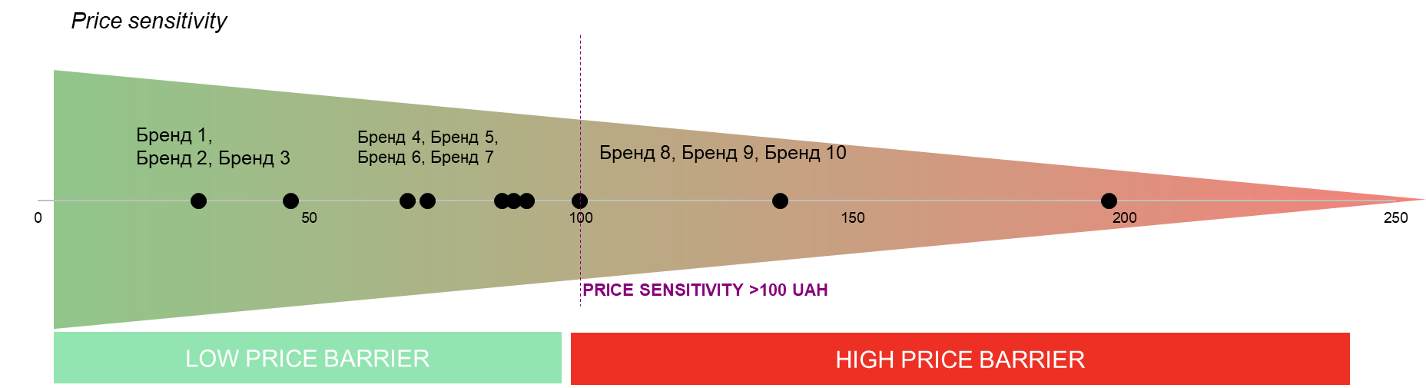
After 100 UAH price becomes the main factor in choosing a product but only in this specific category

Slide 22
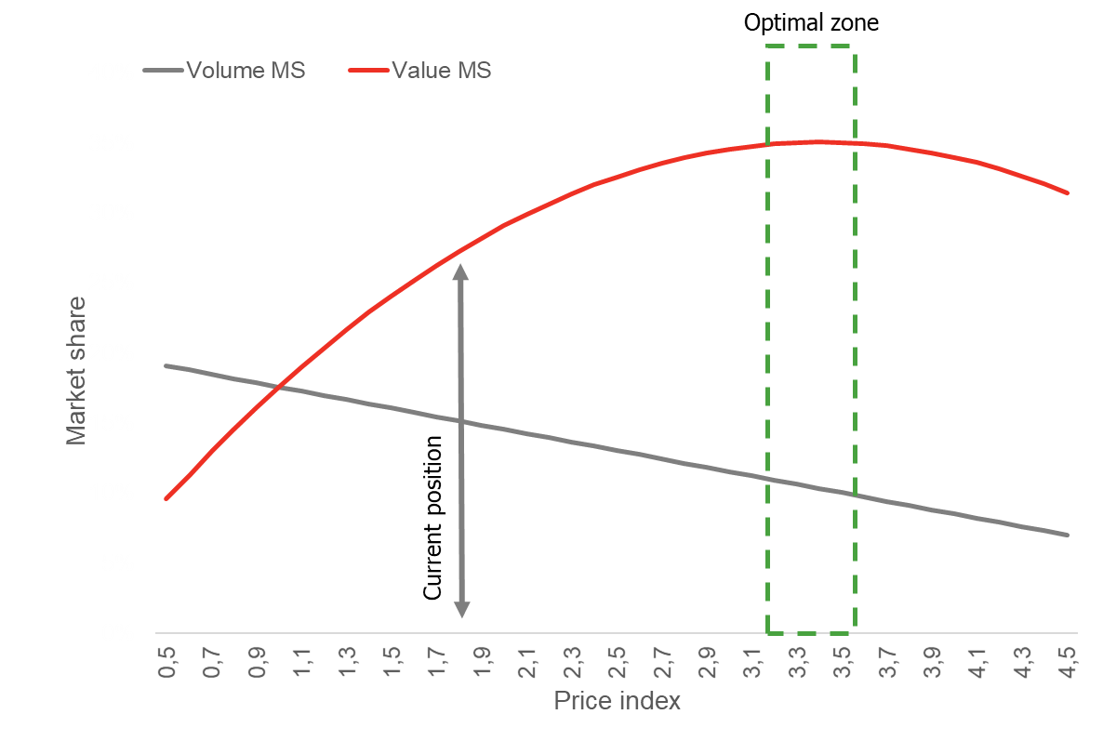
Price elasticity for pharmacy and FMCG categories

Slide 23
case 4
TV vs PRICE PROMO
FMCG / FOOD

Slide 24
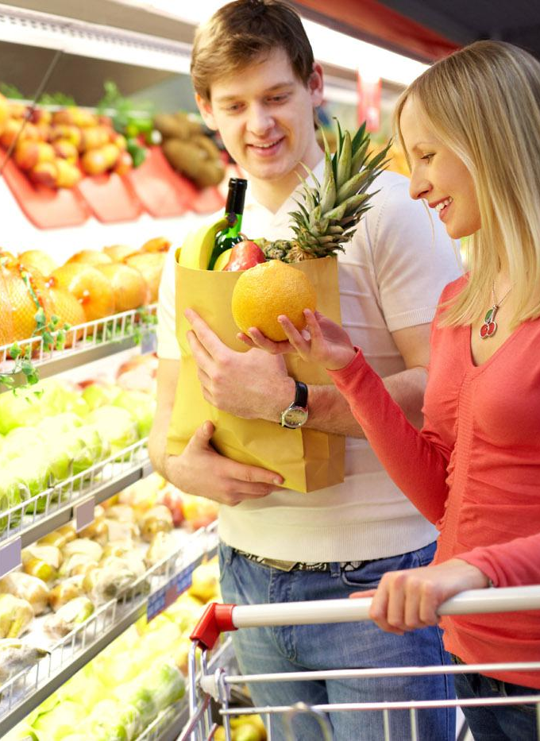
The FMCG category is actively solving the issues of data collection

Slide 25
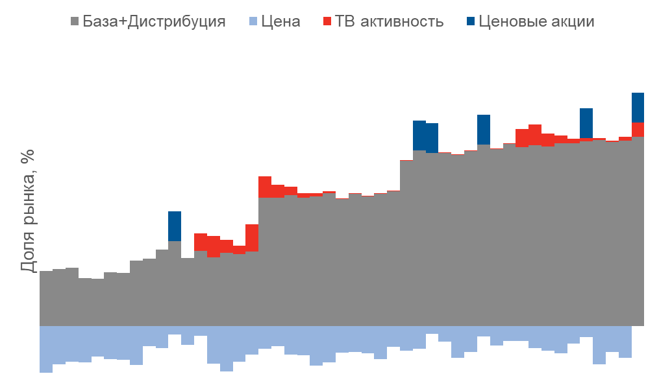
Theory: price rising may cause a drop in market share
Practice:
The main factor in the market share growth is the level of distribution
Price is one of the key factors affecting sales.
A significant increase in prices leads to a decrease in sales and a loss of market share
Price promotions bring ~ up to + 3% MS
TV activity brings ~ 2% to 10% MS

Slide 26
case 4
HALO EFFECT
FMCG / FOOD

Slide 27
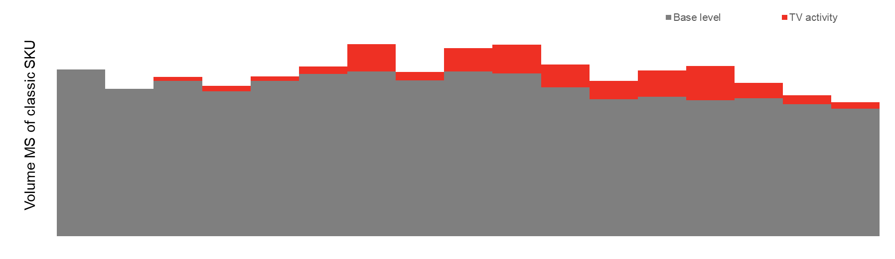
Halo effect – how launch of new products give the impact for the whole brand
TV efficiency when launching a new product is much higher than just image communication
Advertising Performance Coefficient | 1 | *3,1 | *1,5 | *3,4
 | Image communication | Launch a new taste #1 | Image communication | Launch a new taste #2

Slide 28
case 5
REGIONAL ANALYTICS
FMCG / RETAIL

Slide 29
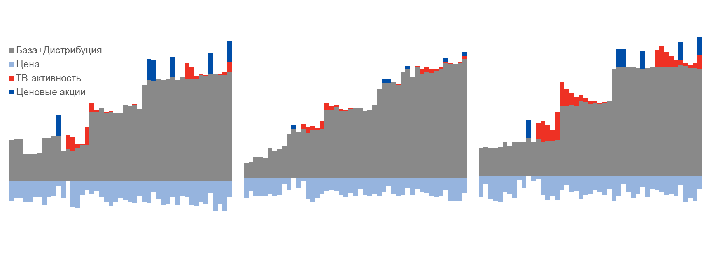
In most cities, advertising generates sales growth as well as the national average, but there are regional differences
We can determine regions whose residents react worse to TV advertising and regions in which TV advertising brings more sales than the national average
DNIPRO
KHARKIV
ZAPORIZHZHYA
Base + Distribution
Price
TV activity
Price promo
Коэффициент эффективности (отдача от рекламы)
Media input koef.
1 | *0,75 | *2,5

Slide 30
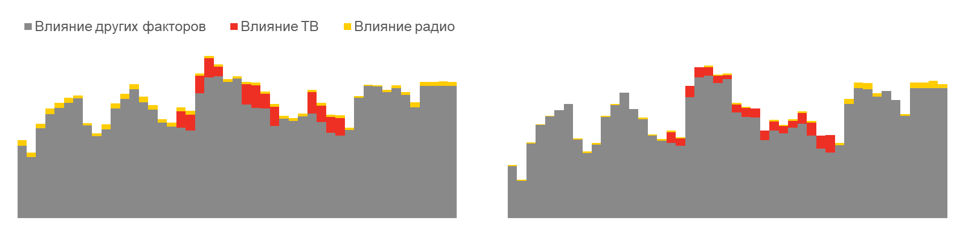


Regional media-split optimization
MUKOLAIV
VINNITSA
Influence of other factors
Influence of TV
Influence of radio
+1000 recalls
+350 recalls
+500 recalls
+200 recalls
Radio is a good tool for business indicators growth in the context of individual cities
Media activity has different efficiencies depending on the city, which makes it possible for ROMI to grow if the investments are correctly allocated

Slide 31
case 6
CONTRIBUTION OF DIGITAL ACTIVITY
PHARMACY

Slide 32
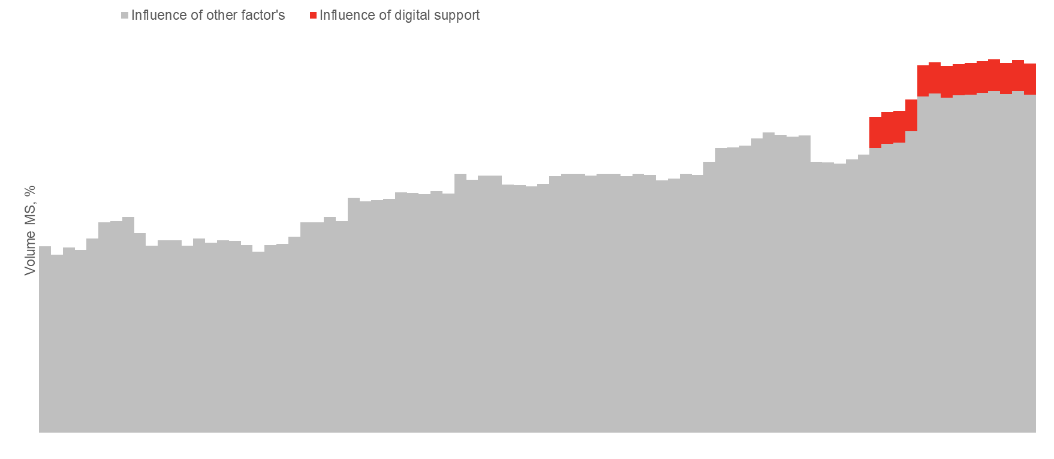
Econometric modeling helps determine the impact of all factors on sales: digital is an effective tool for sales growth
Impact of online activity
Генерация благодаря онлайн-активности

Slide 33
case 7
NEW INSIGHTS
ONLINE CLOTHING STORE

Slide 34
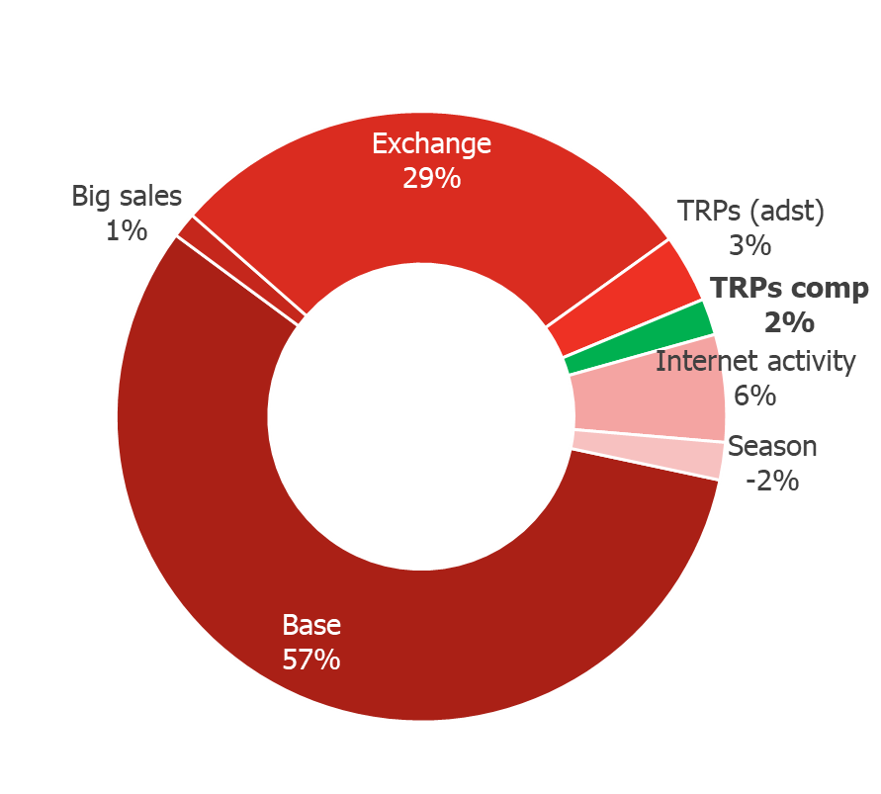





How media activity of competitors grow brand sales
The main factors of influence:
Digital activity
+3К
Brand’s TV activity
Competitor’s TV activity
+2К
+1К
New users
«Big sales»
+1К
Exchange rate
+15К
Seasonality
-7К

Slide 35
Brand Metrics ® - scenario forecasting tool in marketing and business simulations
Opportunities:
Scenario Forecasting and Business Simulations
    For example:
    What will happen if we relocate the budget for TV activity to work with doctors and pharmacists?
    What will happen if we strengthen TV support by X%?
    What will happen if we raise prices by X% and increase the work with doctors and pharmacists by Y%?
Forecasting the target metric with different options
Calculation of the elasticity of the target metric by influencing factors
Creative analysis
Analysis and performance monitoring of different communication channels
Best Pricing Guidelines
Recommendations for an Optimal Media Strategy
And many other…
We find the optimal combination of parameters for achievement of business goals
Regular support of the model allows you to maximize the return on each factor, ultimately it allows you to get the necessary business results for a minimum budget or higher business results for an available budget

Slide 36
What else
DATA /
PARTNERSHIP /
TEAM
OMD Intelligence
Brand Metrics ®
Kiev, st. Zhilyanskaya, 31
intelligence_info@md.kiev.ua
Tel.: +38 050 465 7856
Fax: +38 044 461 1412

