Slide 1
Hacking ML for Marketing
October 2018

Slide 2
Largest consignment store
$130M+ invested
1000+ employees
4 distribution center
Tetiana Torovets
Chris Homer Co-Founder & CTO at thredUPddd
Chris Homer
Chris Homer
Machine Learning Engineer at thredUP
Deputy head of data science department at Zoral
Chief analyst at Prominvestbank
Co-Founder & CTO at thredUP
Solution Specialist at Microsoft
Harvard Business School & Princeton University

Slide 3
Notes:
Quick history/motivation for thredUP

Slide 4
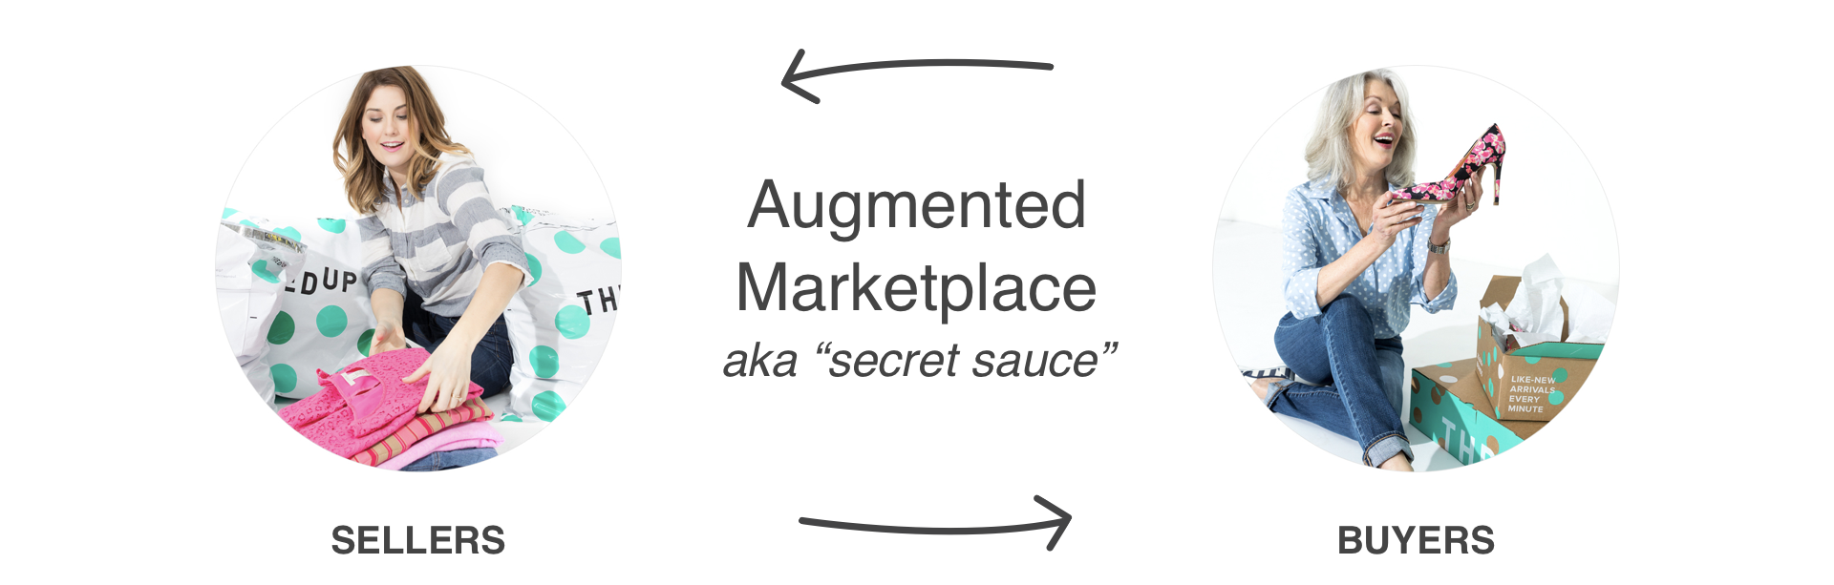
THE THREDUP ECOSYSTEM
Convenient Pre-Paid Bag
Earn Cash or Donate
Do Good
Amazing prices
Wide assortment
Fresh selection everyday
Notes:
Value proposition

Slide 5
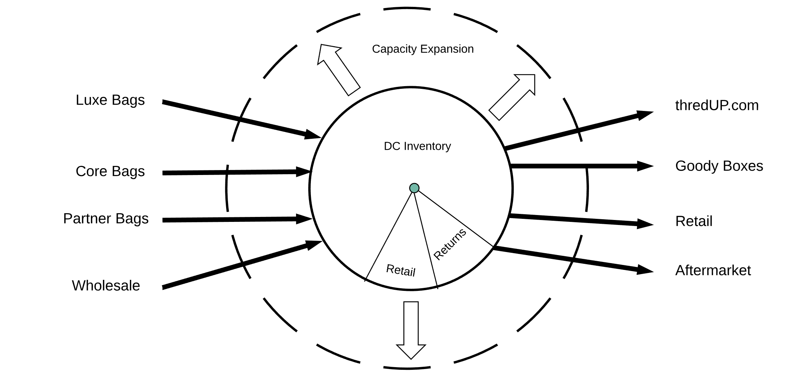
THE THREDUP ECOSYSTEM
Notes:
Complexity / dynamics of the marketplace

Slide 6
THE THREDUP ECOSYSTEM
Operating the Marketplace
Notes:
Complexity / dynamics of the marketplace

Slide 7
THE THREDUP ECOSYSTEM
Growing the Marketplace
Notes:
At any given point in time, capacity is fixed, there for growing the marketplace is about inventory quality & velocity.

Slide 8
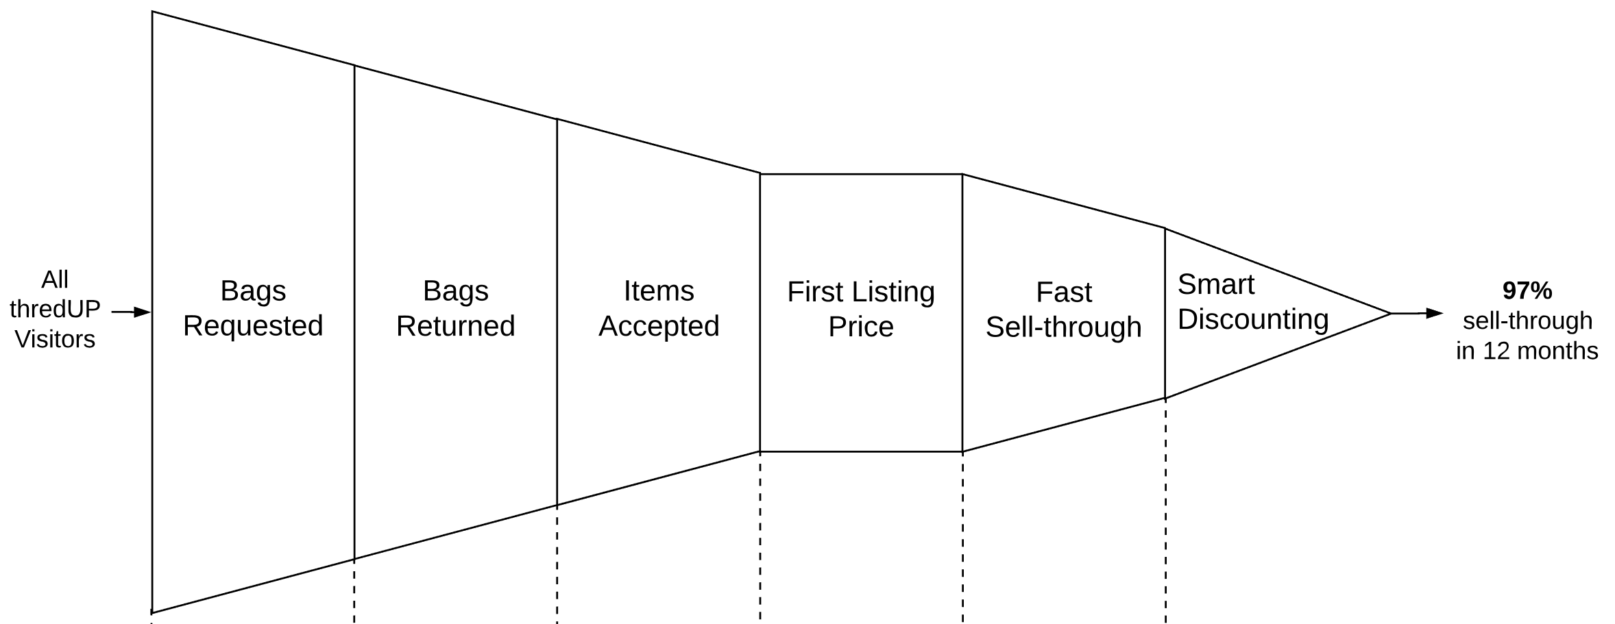
THE THREDUP ECOSYSTEM
Augmenting the Marketplace
Marketing
Highly Efficient Marketing
Supplier Scoring
Partners
Supply Lifecycle
Quality + Expected Value
Proprietary Pricing Algorithm
Personalization
Search Notifications
Discounting Algorithm
Notes:
Many sophisticated touchpoints for making decisions that help to maximize the value processed & sold through the marketplace
…. Quick run-through each …
Click
At the top of the funnel, of course, is an engine for “highly efficient marketing”

Slide 9
MARKETING IN THREDUP
Acquisition Channels
Social networks: Facebook, Pinterest
Paid search: Google, Bing, GDN (Google Display Network), PLA (Product Listing Ad)
TV
SEO: Organic, Branded Google Search, Branded Bing Search
Influencers: https://www.usmagazine.com/celebrity-news/news/how-cheryl-burke-prepared-for-fiance-matthew-lawrence-to-move-in/
Notes:
Optimization of budget
Main optimization channels

Slide 10
MARKETING IN THREDUP
Models
Model Description | Example Usage
Will a new user make her first purchase in the next 14 days? | Who should see facebook ads?
Will a new user make her first purchase in the 60 days after signing up? | Estimate conversion rate of facebook ads
Will an existing user make another purchase in the next 30 days? | Who gets what discount?
When will a group of signups convert? | Estimate conversion rate of facebook ads
How many purchases will a user make in the future and what will be their AOV? | Evaluate payback of marketing channels
Estimate the number of signups we get from each TV ad | Evaluate the efficiency of TV spots

Slide 11
MARKETING IN THREDUP. CR PREDICTION
Predict the First Purchase of User
Predict probability of purchase in the next 14 days to create target auditory for ads
Predict probability of purchase in the next 60 days to estimate Conversion Rate
Only users who have NOT made a purchase yet.
The score uses browse behavior information, demographic data, email information

Slide 12
MARKETING IN THREDUP. CR PREDICTION
Predict the First Purchase of Users in the next 14 days
Algorithms used: Random Forest Classifier
Tools: Redshift, DataBricks
Model performance: Accuracy = 89.6%
(# correct predictions / Total # of predictions) * 100
Business impact: CPA decreased by 50%

Slide 13
MARKETING IN THREDUP. CR PREDICTION
Predict the First Purchase of User
Today
Predict
14 day conversion
No purchasers signed up last 7 days
Output:(0,1)
Model runs every 3 hrs
Today
Predict
14 day conversion
2010
Output:(0,1)
All NP

Slide 14
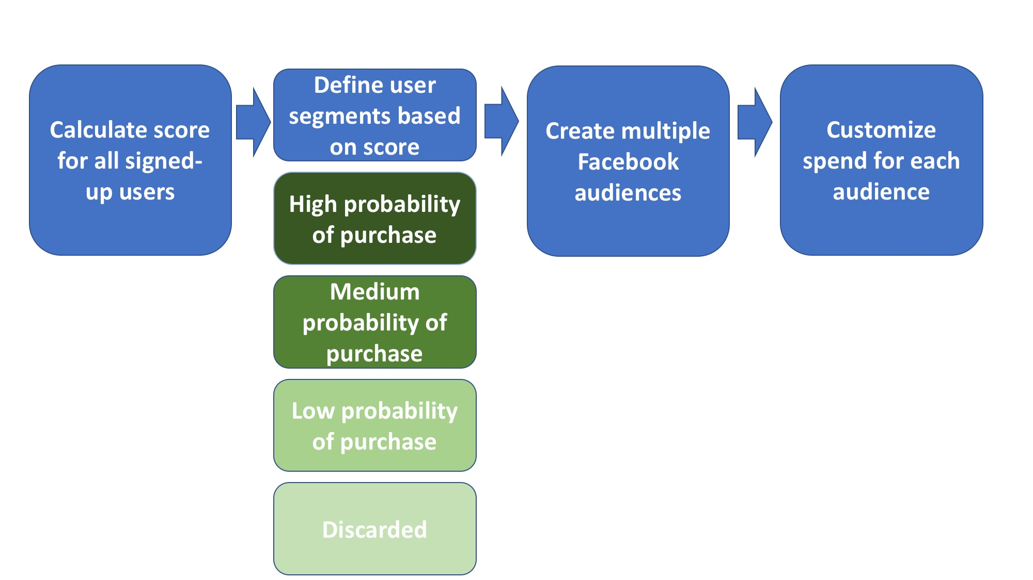
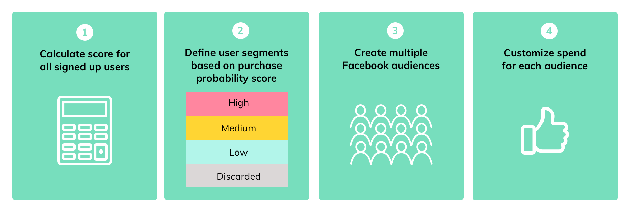
MARKETING IN THREDUP. CR PREDICTION
Target Audiences

Slide 15
MARKETING IN THREDUP. CR PREDICTION
Predict the First Purchase of User in the next 60 Days
Algorithms used: Random Forest classifier
Tools: Redshift, Python
Model performance: Accuracy = 91.3%
Business impact: Ability to estimate long-term CR and make better
decisions about the budget

Slide 16
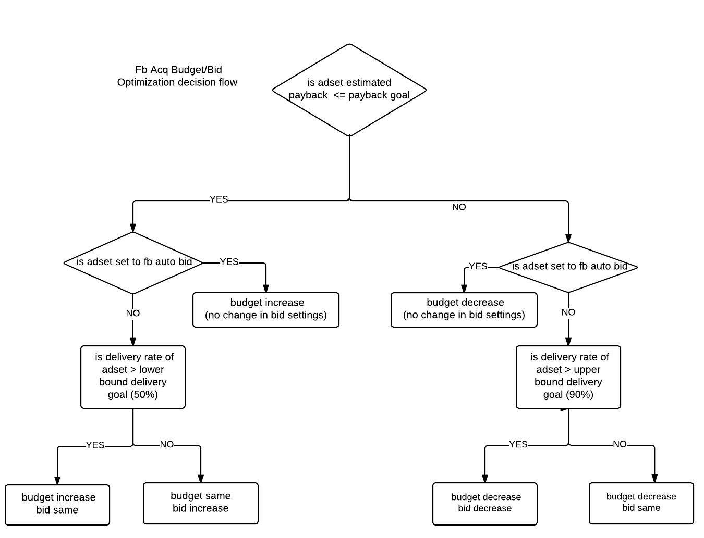
MARKETING IN THREDUP. CR PREDICTION
Payback Optimization
Payback = Cost Per Acquisition (CPA) / Lifetime value (LTV)
CPA = Cost Per Lead (CPL) / Conversion Rate (CR)
Notes:
Optimization of budget
Main optimization channels

Slide 17
MARKETING IN THREDUP. CPA OPTIMIZATION
When will a group of signups convert?
Algorithms used: Cox regression
Tools: Redshift, Python
Model performance: Concordance index 0.87
Business impact: Decreased payback by 5%

Slide 18
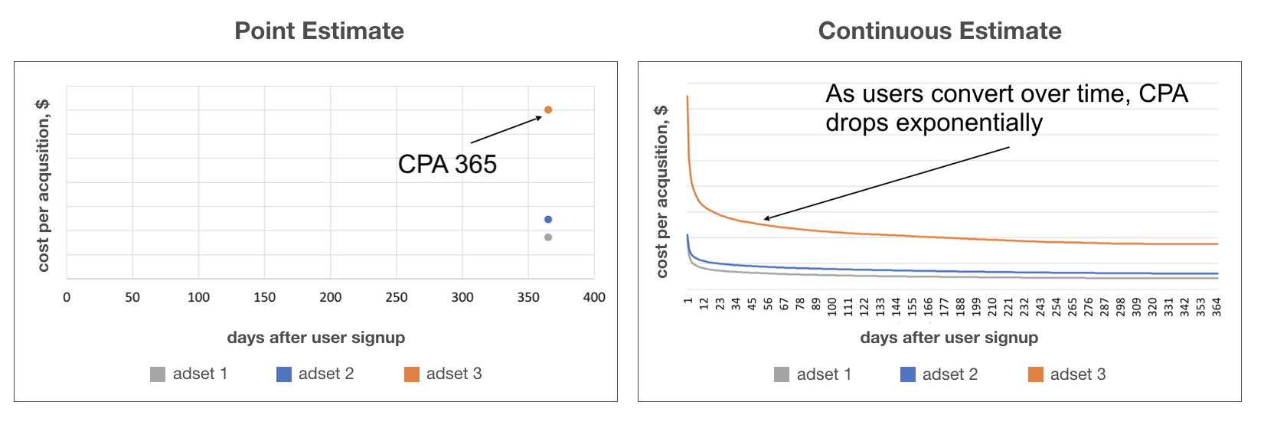
MARKETING IN THREDUP. CPA OPTIMIZATION
1 year CPA prediction for different advertising campaigns
We estimate CPA for every paid advertising campaign on a daily basis to allocate marketing budget properly.
We used “point” estimation for 1 year CPA.
We decided to switch to continuous CPA estimation to increase accuracy and have more control over predictions on any given time window.

Slide 19
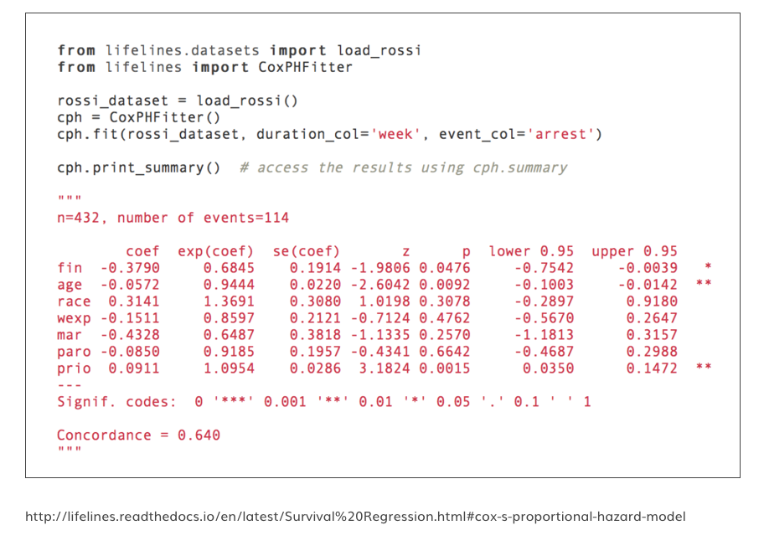
MARKETING IN THREDUP. CPA OPTIMIZATION
For survival rate prediction we used Cox Regression implemented in lifelines package
Duration
Time between user’s signup and purchase OR time between user’s signup and current date
Event
User’s first purchase at thredUP site (conversion)
Features
Data about advertising campaign
Data about user

Slide 20
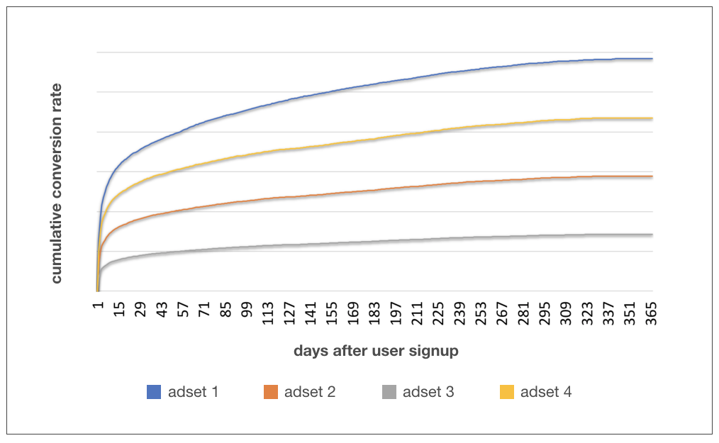
MARKETING IN THREDUP. CPA OPTIMIZATION
Predicted Cumulative Conversion Rate
1 year Cost Per Acquisition
=
Cost Per Lead / 365 Conversion Rate
Continuous conversion rate prediction is the key component of the Cost Per Acquisition prediction

Slide 21
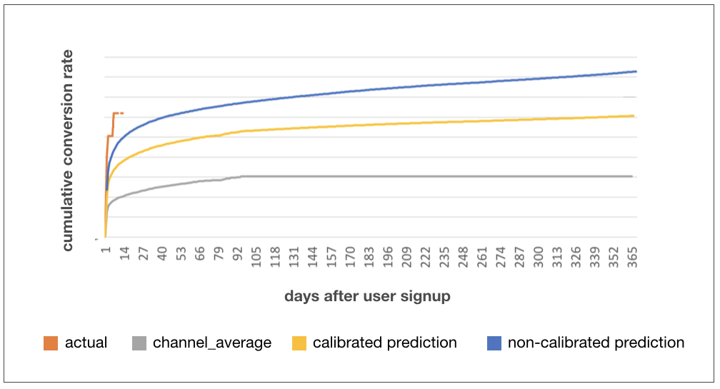
MARKETING IN THREDUP. CPA OPTIMIZATION
For newly started campaigns, the number of users can be low.
For reliable prediction, we mix channel average with prediction for advertising campaign.
More signups -> higher weight for the advertising campaign.
Weight of the advertising campaign in prediction depends on the confidence interval of the actual survival curve (Kaplan-Meier estimation).
Cumulative conversion rate depends on days since signup
Actual survival curve - confidence interval width is high
Final prediction is shifted towards channel average

Slide 22
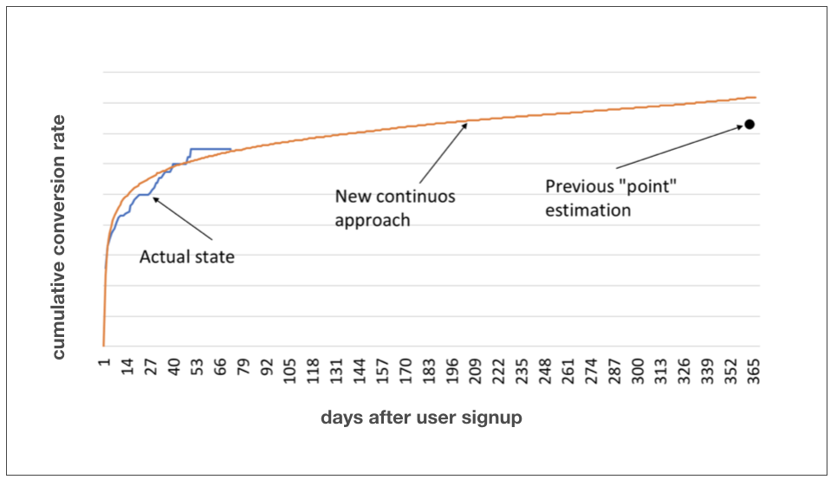
MARKETING IN THREDUP. CPA OPTIMIZATION
Control over daily CR and CPA
Quick estimation of CR/CPA for the advertising campaigns with low # of signups
Better prediction accuracy
Comparison of CR prediction with previous and new approaches

Slide 23
MARKETING IN THREDUP. NEXT PURCHASE PREDICTION
Predict Next Purchase of User
Algorithms used: Random Forest Classifier
Tools: Redshift + Python
Model performance: AUC = 96.1%
Business impact: Find the most appropriate email content for users,
vary discount %

Slide 24
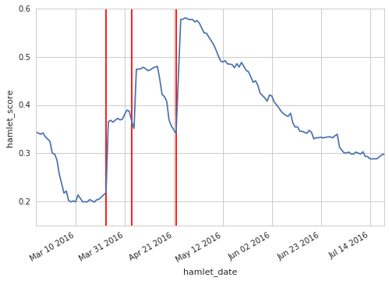
MARKETING IN THREDUP. NEXT PURCHASE PREDICTION
Orders
User score
The score predicts the likelihood a buyer will make another purchase in 30 days.
Only users who have made a purchase in the last year get scores.
The score uses browse behavior, order and supply history, email history, and other variables to make this prediction.

Slide 25
MARKETING IN THREDUP. LTV PREDICTION
How many purchases will a user make in the future?
Algorithms used: Beta Geo Fitter, Gamma Gamma Fitter
Tools: Redshift + Python
Model performance: Average difference in counts between actuals and
predictions: 0.002
Average difference in AOV between actuals and predictions: $2.56 (4%)
Business impact: Decrease payback by 10%

Slide 26
MARKETING IN THREDUP. LTV PREDICTION
Illustration of the mathematical algorithms used for LTV prediction were taken from Jean-Rene Gauthier, Ben Van Dyke paper:
https://www.datascience.com/blog/intro-to-predictive-modeling-for-customer-lifetime-value

Slide 27
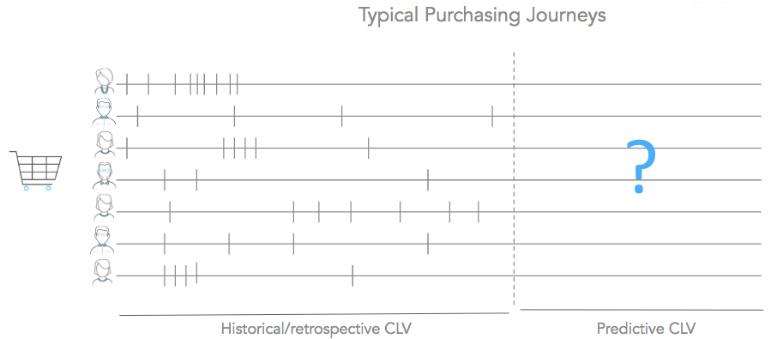
MARKETING IN THREDUP. LTV PREDICTION
Typical Purchasing Journeys
Historical / Retrospective CLV
Predictive CLV

Slide 28
MARKETING IN THREDUP. LTV PREDICTION
 | Non-Contractual Settings | Contractual Settings
Continuous Purchases | No contract. The company does not know when a customer defects. Switching costs are low. Can purchase at any time | Contract involved The company knows when a customer defects. Can purchase at any time
Discrete Purchases | Same non-contractual settings Purchases occur at fixed frequencies/periods. | Contractual Purchases occur at fixed frequencies/periods.

Slide 29
MARKETING IN THREDUP. LTV PREDICTION
 | Non-Contractual Settings | Contractual Settings
Continuous Purchases | Movie Rentals Medical Appointments Hotel Stays Grocery Purchases Amazon.com thredUP | Costco Membership Credit Cards
Discrete Purchases | Prescription Refills Charity Fund Drives Event Attendance | Magazine/Newspaper Subscriptions Fitness Clubs Most Insurance Policies Streaming Services: Netflix, Hulu, etc Most Cell Phone Plans

Slide 30
MARKETING IN THREDUP. LTV PREDICTION
Lifetime: The period over which a customer is maintaining his or her relationship with the company
Purchase rate: His parameter corresponds to the number of purchases a customer will make over a given period of time
Monetary value: This part of the model is concerned with assigning a dollar amount to each future transaction

Slide 31
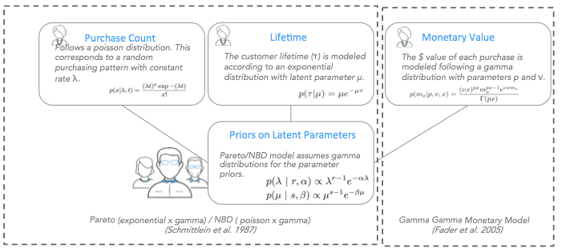
MARKETING IN THREDUP. LTV PREDICTION
Pareto / NBD model
Notes:
Optimization of budget
Main optimization channels

Slide 32
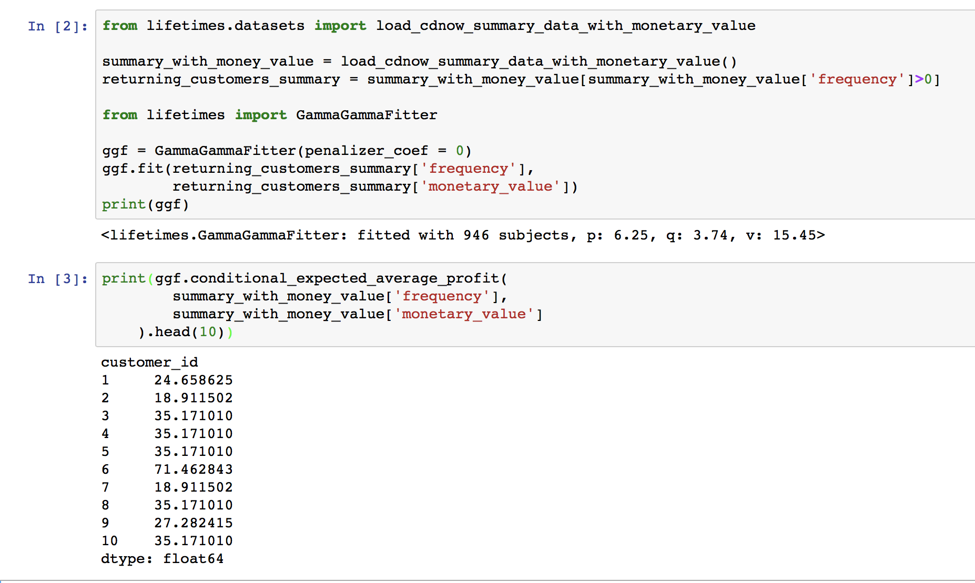
MARKETING IN THREDUP. LTV PREDICTION
Monetary Value Prediction
At the customer level, the transaction/order value varies randomly around each customer’s average transaction value.
The observed mean value is an imperfect metric of the latent mean transaction value E(M), where M represents the monetary value.
Average transaction value varies across customers, though these values are stationary.
The distribution of average values across customers is independent of the transaction process.
Notes:
Optimization of budget
Main optimization channels

Slide 33
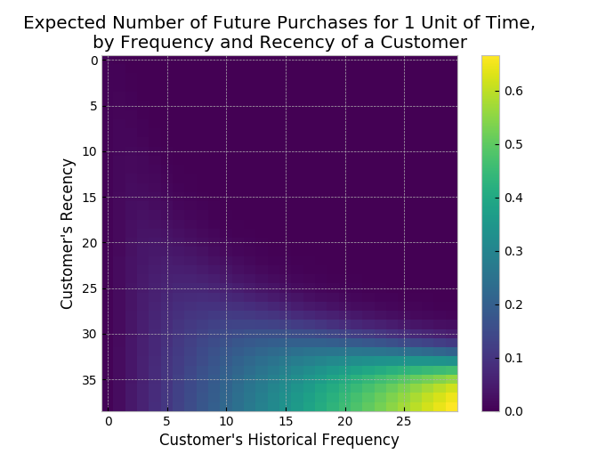
MARKETING IN THREDUP. LTV PREDICTION
BG/NBD Model
NBD/Pareto model is computationally expensive to train.
Beta-geometric model is easy to implement.
It requires next parameters for estimation:
Recency - represents the age of the customer when they made their most recent purchases
Frequency - represents the number of repeat purchases the customer has made
T - represents the age of the customer
Notes:
Optimization of budget
Main optimization channels

Slide 34
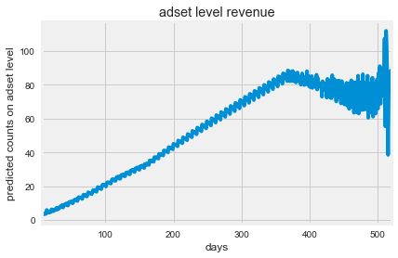
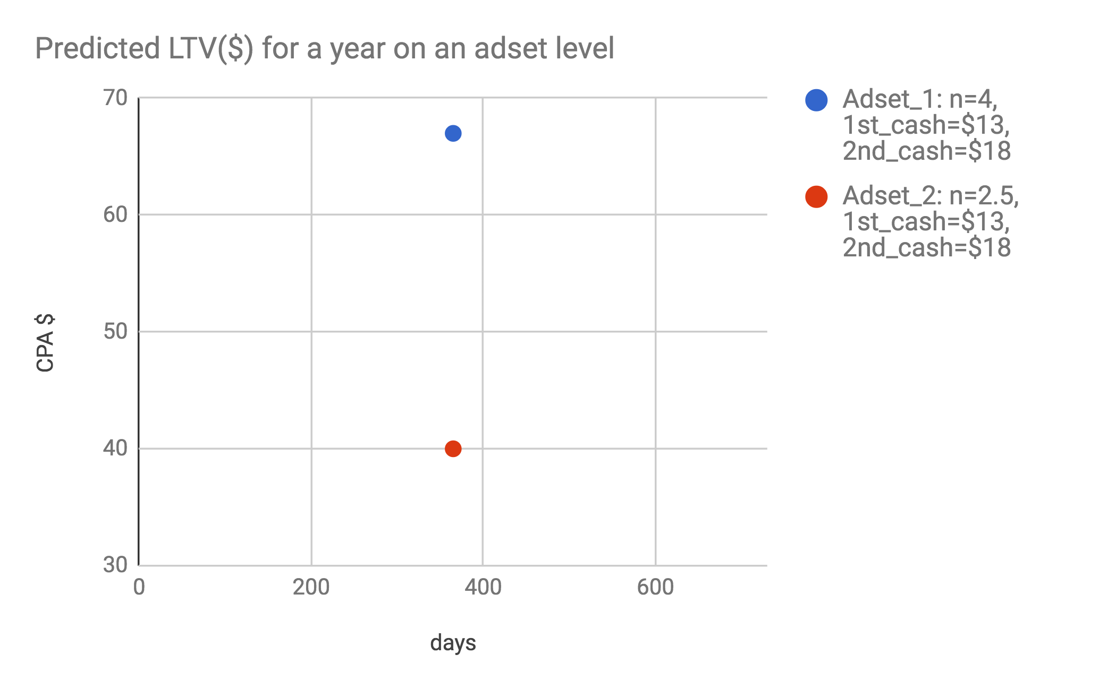
MARKETING IN THREDUP. LTV PREDICTION
Improvement with BG/NBD modeL
Current rules-based:
LTV_365
LTV
One prediction per day
Continuous predictions of the future

Slide 35
MARKETING IN THREDUP. LTV PREDICTION
Improvements
Current Rules-Based:
LTV = first cash average + (N-1) * second plus cash average
Aggregated on an adset or channel level
LTV is user level n combined with business-wide assumptions about cash on the 1st order and cash on the 2+ order
The 1st and 2+ cash assumptions are the same for all users
The n estimate is tied to a 1 year time horizon
Future:
LTV is the combination of two estimations:
The # of orders each user will place each week in the future
The AOV of future orders
LTV = AOV * Count
LTV model is dependent on users’ purchase recency and frequency, and time since first purchase
LTV currently only reflects revenue (next step is product margin)
AOV is at the user level and independent of purchasing frequency
For users who made only a few transactions, their AOVs are heavily weighted to the population mean

Slide 36
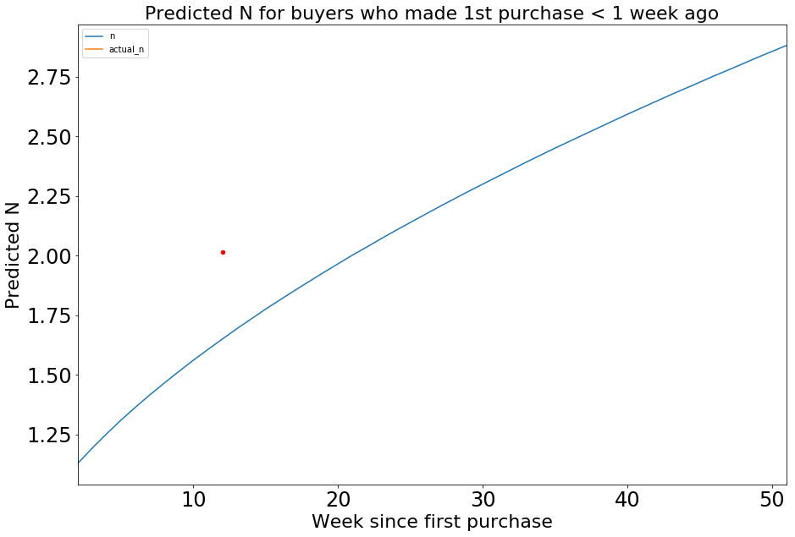
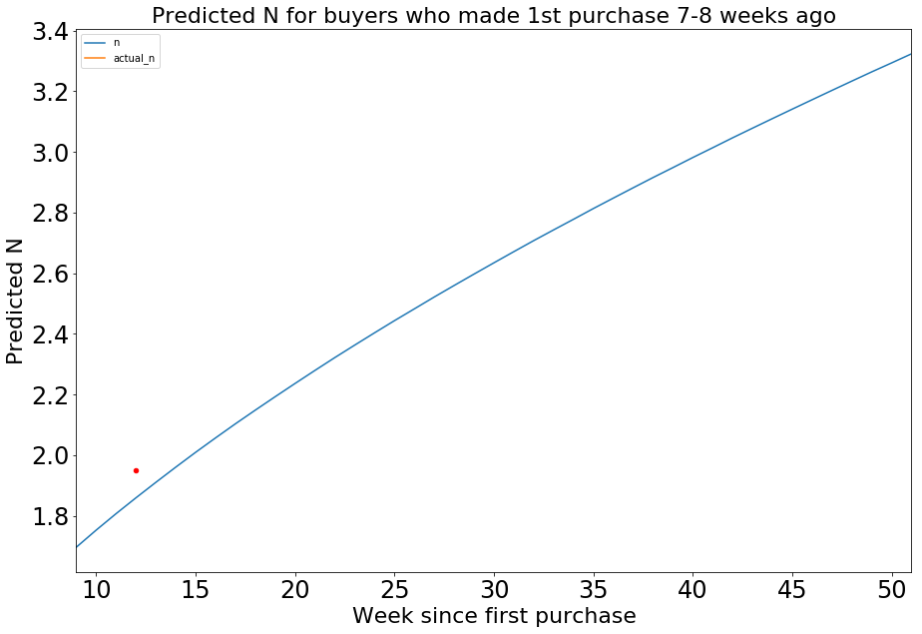
MARKETING IN THREDUP. LTV PREDICTION
Cons with the Current Approach
It is important to improve model accuracy for recent purchasers
Actual 3 months N
Actual 3 months N
Notes:
TODO: Check statement

Slide 37
MARKETING IN THREDUP. LTV PREDICTION
Statistical Approach vs ML Approach
Statistical Approach | ML Approach
Does not require observation period to define target | Requires observation period to define target
Does not consider individual features ( wealth rank, search history etc.) | Relies on individual features ( wealth rank, search history etc.)
Produces continuous curve of N | Produces single point prediction

Slide 38
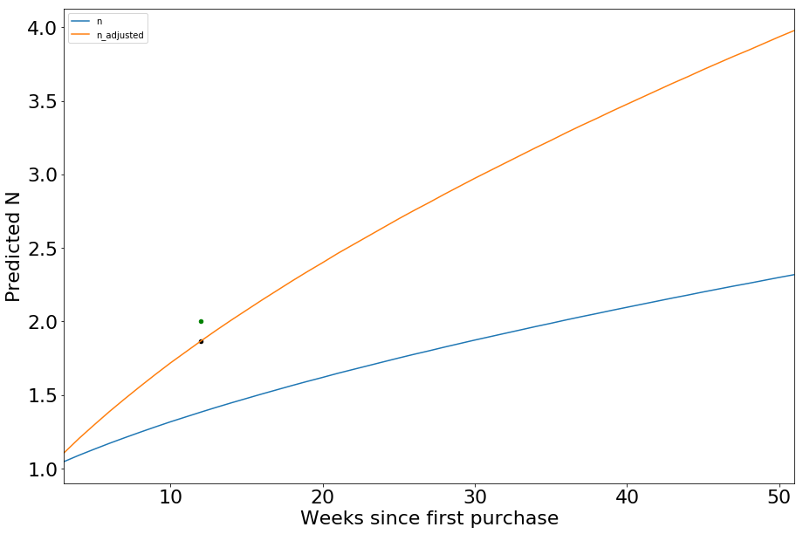
MARKETING IN THREDUP. LTV PREDICTION
Next Steps
We created ML model to predict short term N for each user and adjust long-term predictions
This model allows:
Adjust user-level predictions
Consider important user-level information
Actual 3 months N
3 months N predicted with regression model
Notes:
Optimization of budget
Main optimization channels

Slide 39
MARKETING IN THREDUP. TV ATTRIBUTION
TV attribution
Algorithms used: Linear regression (for baseline)
Tools: Redshift, Python, Spark
Model performance: -
Business impact: Optimise expenses for TV channel

Slide 40
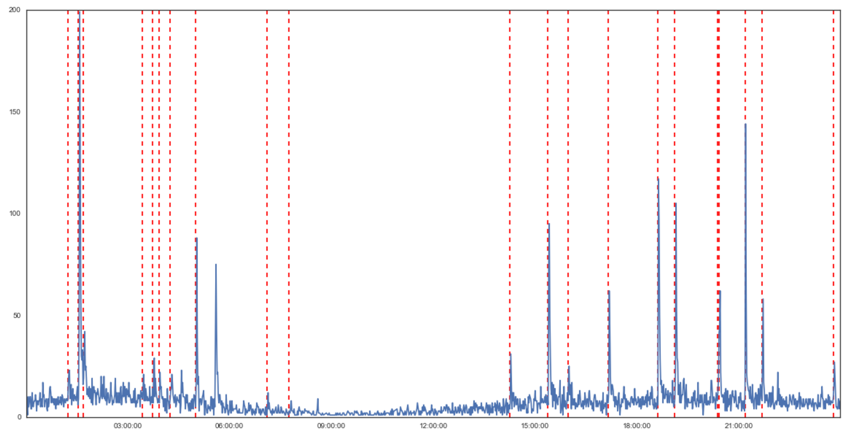
MARKETING IN THREDUP. TV ATTRIBUTION
One Day Snapshot
TV Spot
Signup “baseline” fluctuates with time
Spike

Slide 41
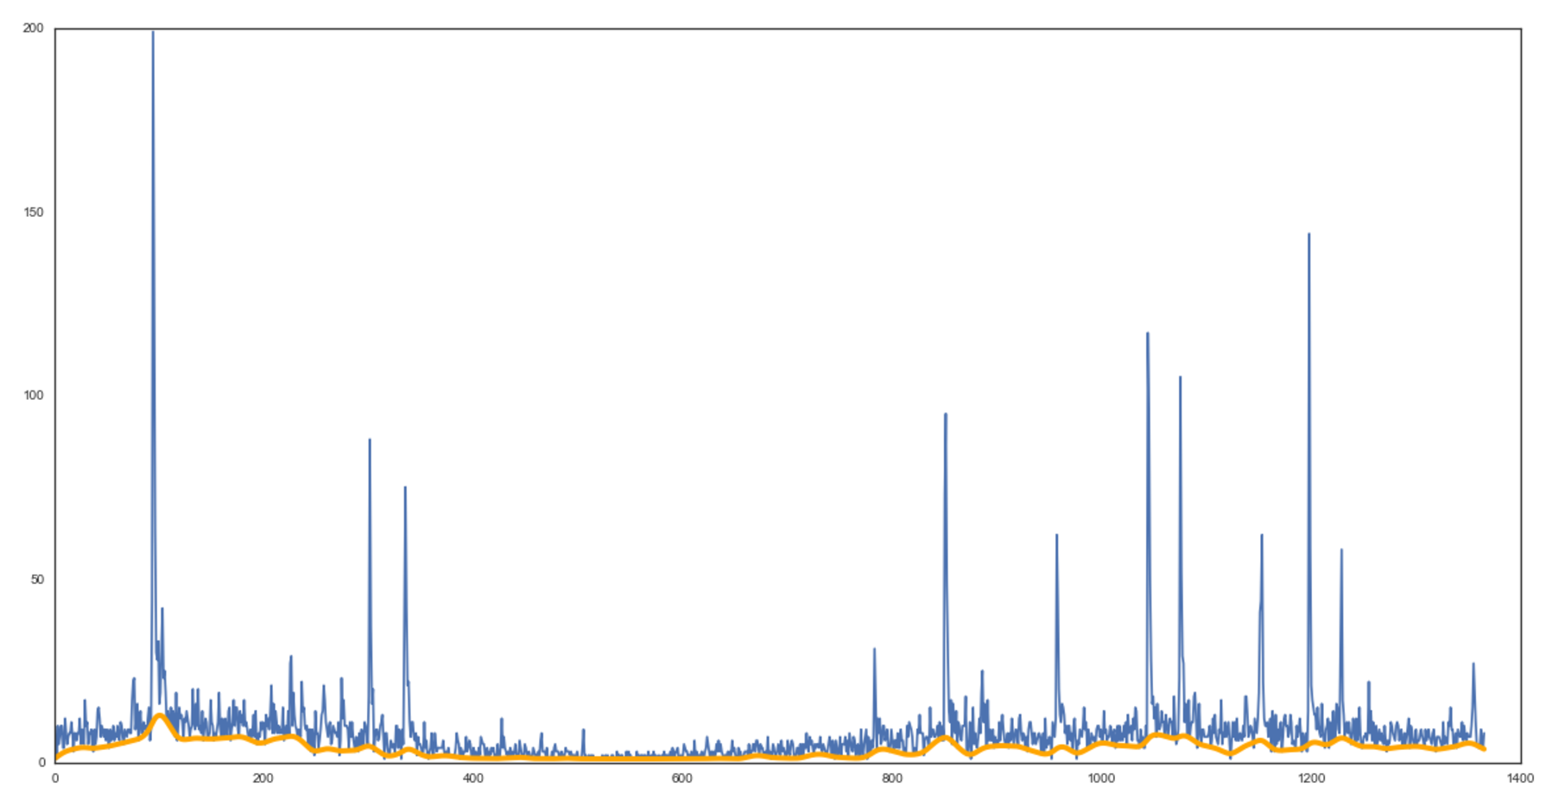
MARKETING IN THREDUP. TV ATTRIBUTION
Orange “baseline” represents Organic & Branded Search traffic in absence of TV spot
Notes:
Baseline Correction with Asymmetric Least Squares Smoothing

Slide 42
MARKETING IN THREDUP. MULTI-TOUCH ATTRIBUTION
Multi-touch Attribution (exploration)
Algorithms used: Logistic regression
Tools: Redshift + Spark + Python
Model performance: -
Business impact: Visibility of cross-channel performance for marketing team

Slide 43
MARKETING IN THREDUP. MULTI-TOUCH ATTRIBUTION
Last Click Attribution
Omnichannel Attribution

Slide 44
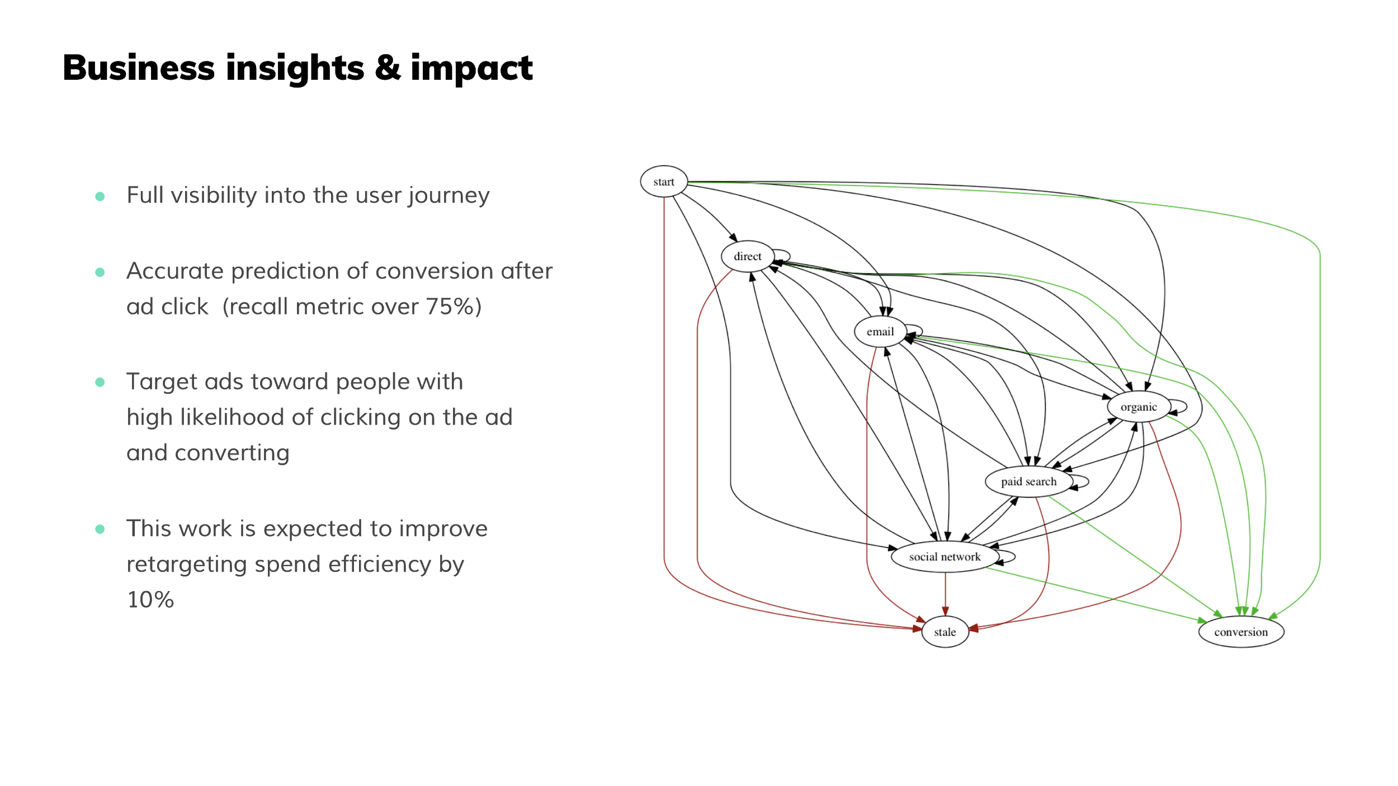
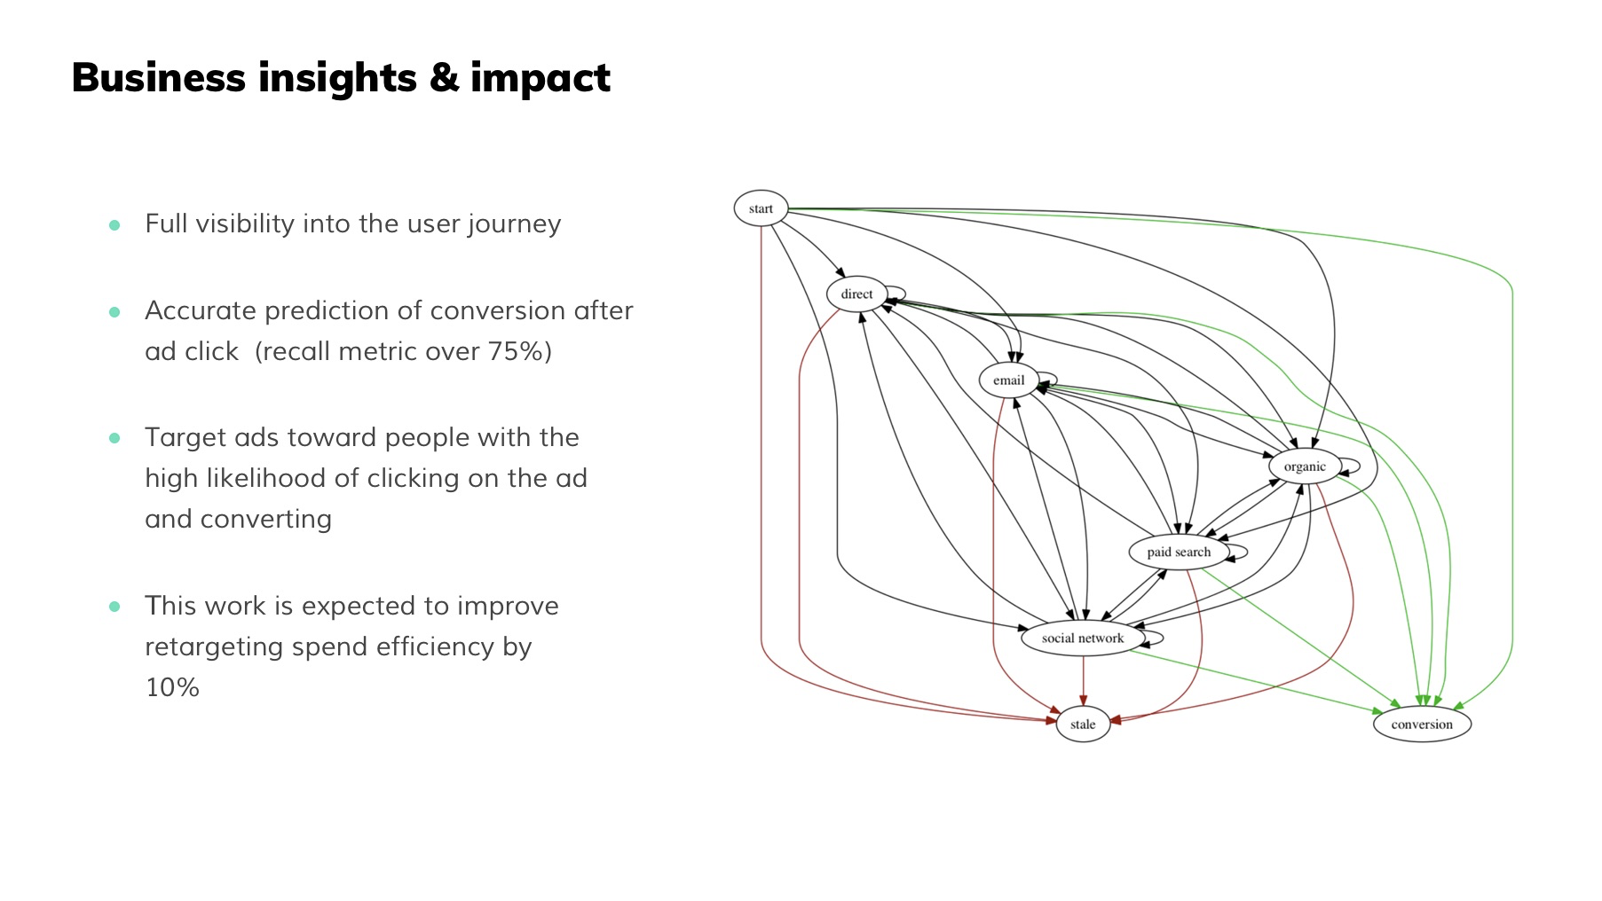
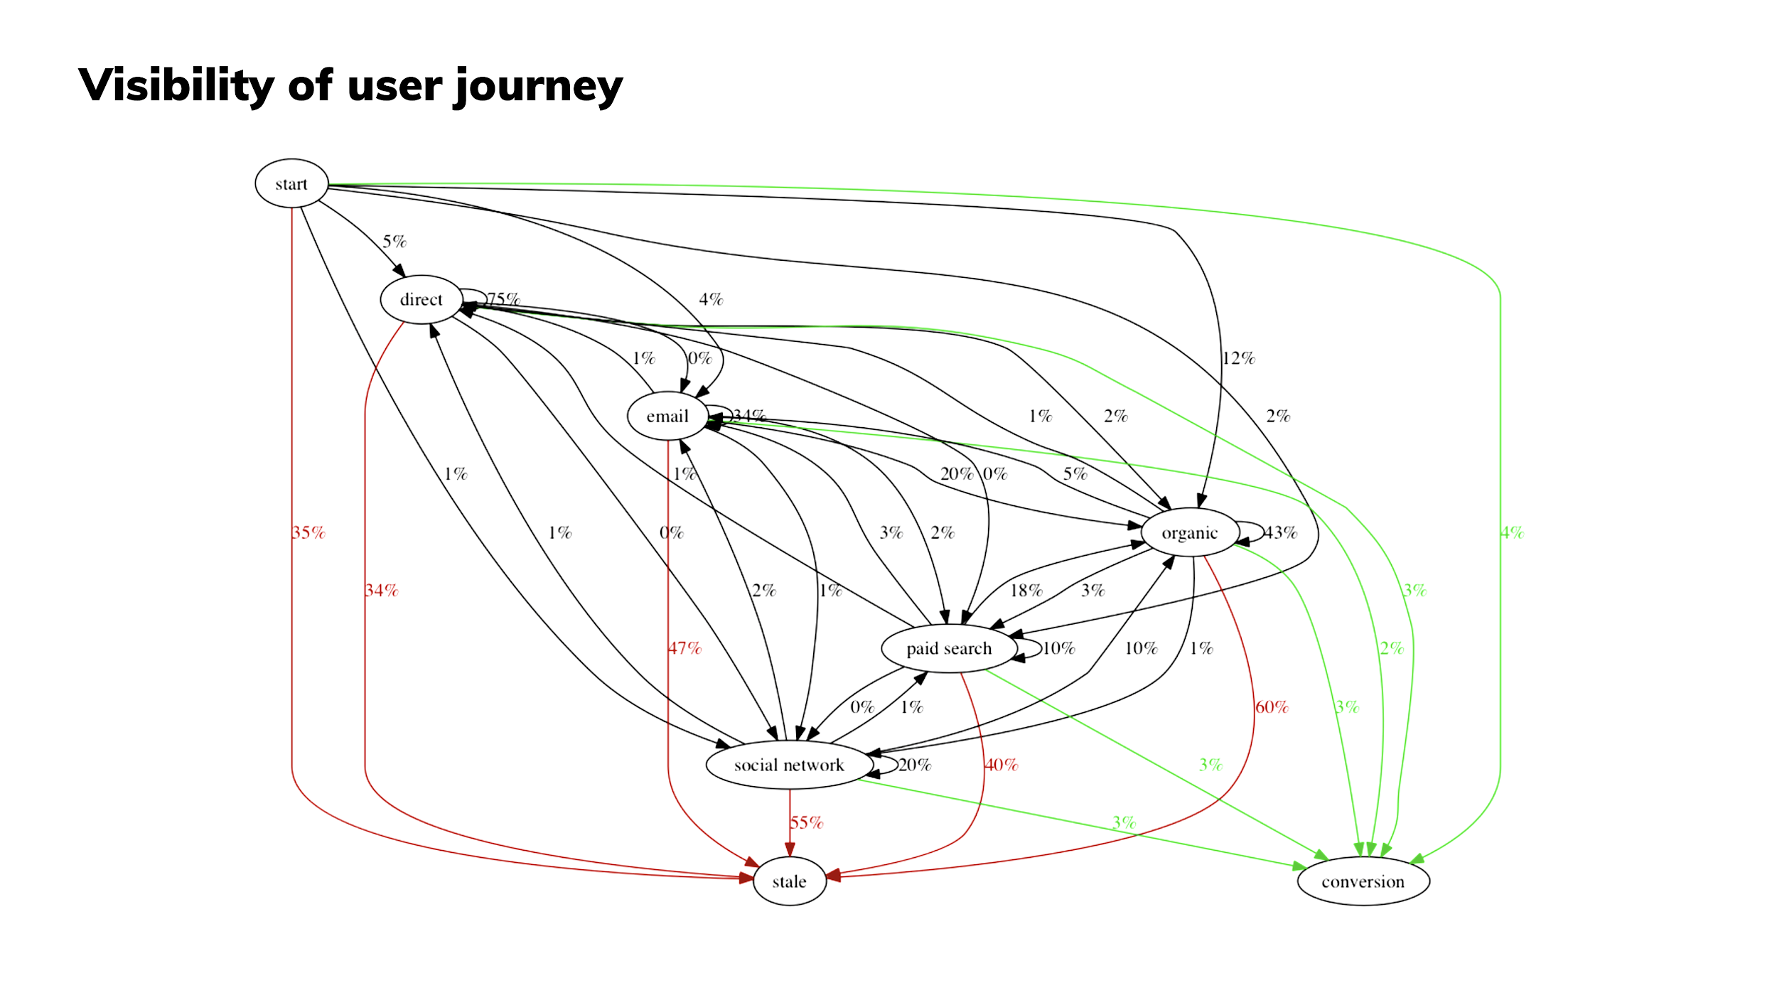
MARKETING IN THREDUP. MULTI-TOUCH ATTRIBUTION
Visibility of the User Journey

Slide 45
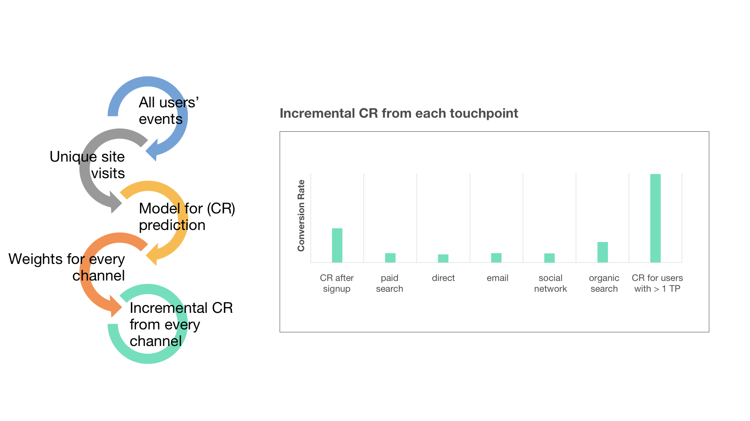
MARKETING IN THREDUP. MULTI-TOUCH ATTRIBUTION
ML for Omnichannel Attribution

Slide 46
Open positions
Senior ML Engineer — Supply Growth and Quality
Senior ML Engineer — Image processing
Senior Java Software Engineer — Data Engineering
Tetiana Torovets
Chris Homer Co-Founder & CTO at thredUPddd
Chris Homer
Chris Homer
Machine Learning Engineer at thredUP
Deputy head of data science department at Zoral
Chief analyst at Prominvestbank
Co-Founder & CTO at thredUP
Solution Specialist at Microsoft
Harvard Business School & Princeton University

