Slide 1
Predicting rare events in the car

Slide 2



Meet the Team
Nazar Sheremeta
Senior Data Science Enginner
Elena Kasianenko
Data Scientist
CloudMade has Kyiv R&D office with 130 person Engineering
team, own car fleet, and Design Studio in London.

Slide 3
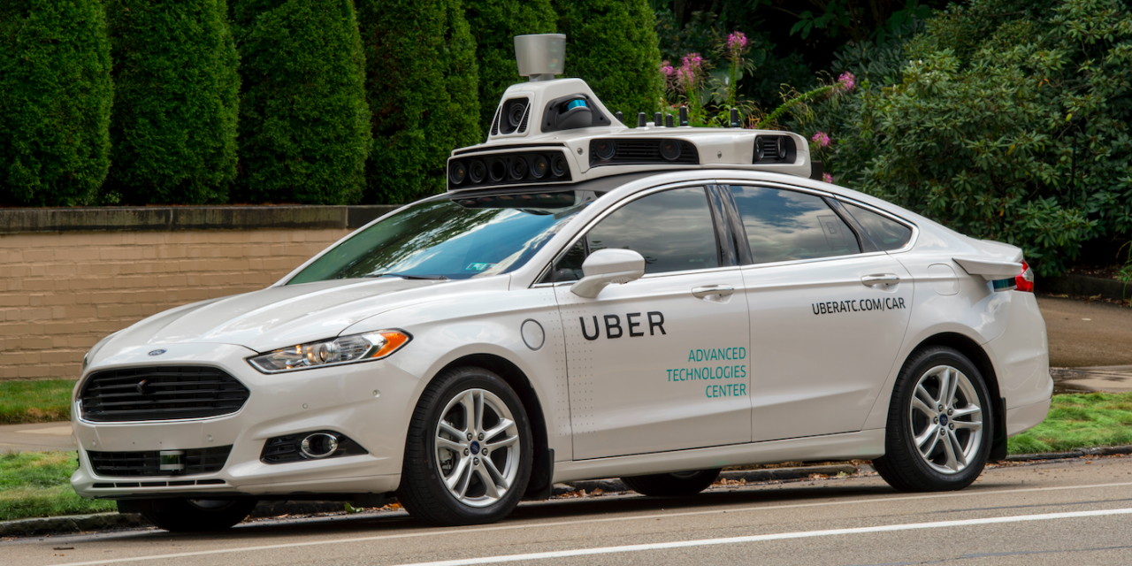
Self driving car

Slide 4
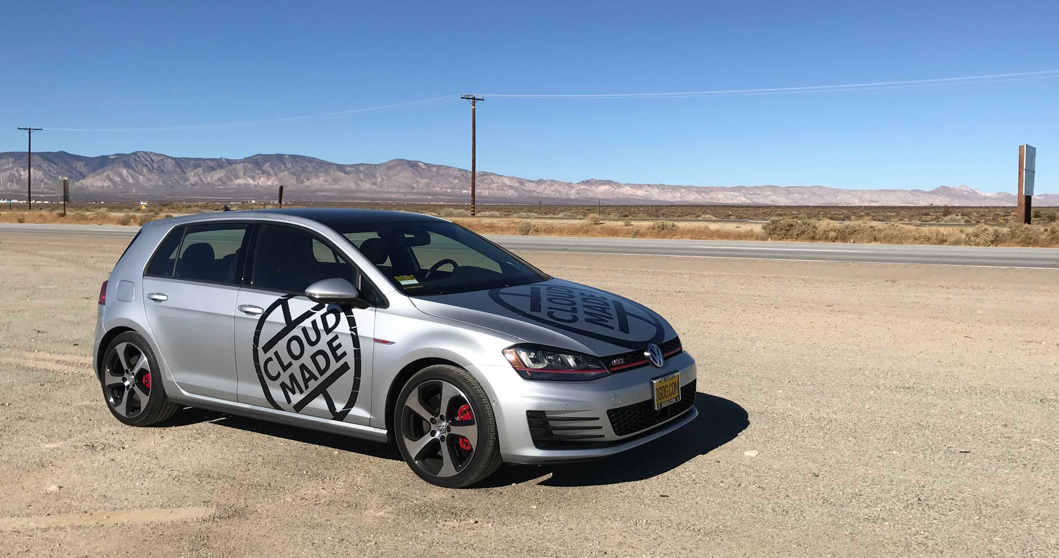
Self driving car

Slide 5
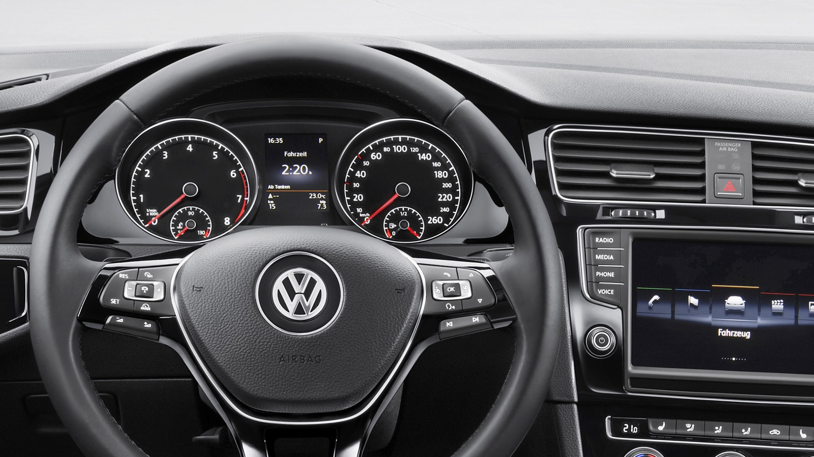
Golf wheel

Slide 6

Predictive Navigation
Personalized Coaching
Intelligent
Climate
Predictive Call List
Smart
Onboarding
Personalized Search
One Driver
Profile
Many Use Cases
Personalized
Parking Options
Intelligent Cabin
Refueling &
Recharging
Predictive
Drive Mode
Predictive
Occupant ID
Predictive Media
Personalized Autonomy

Slide 7
Agenda
What rare events in the car can we predict?
What is Adaptive Cruise Control? What are the issues with it?
Automatic turn on suggestions idea
Crowdsourced map as initial solution
Personalized context
Q&A

Slide 8
Adaptive
Cruise Control

Slide 9
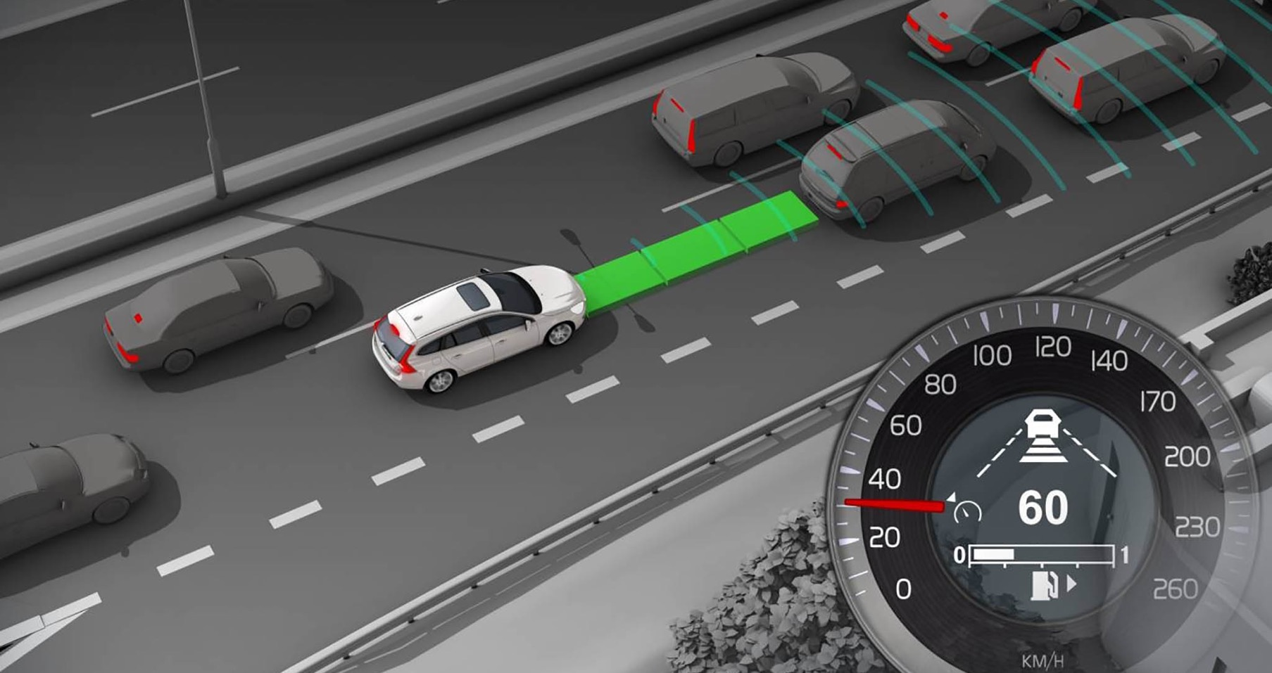

Slide 10
Golf wheel

Slide 11
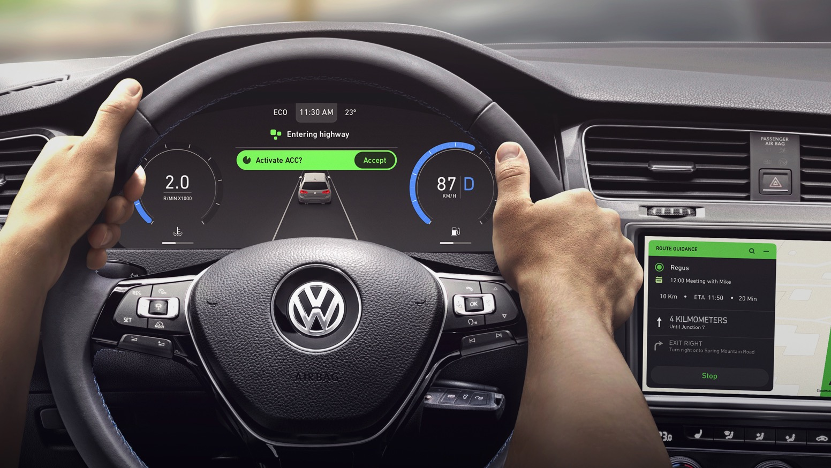
Predictive Adaptive Cruise Control

Slide 12
Problem Definition

Slide 13
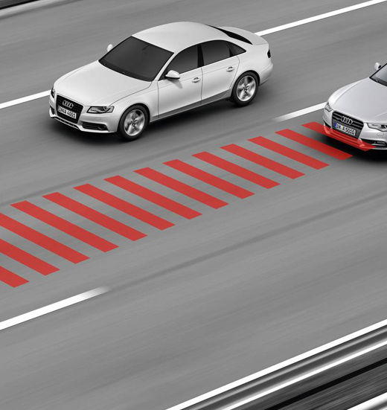
Problem formulation
Problem:
Drivers rarely use ACC.
Our hypothesis:
Drivers just forget or want to drive
by themselves.
Solution:
Provide recommendation to turn on ACC in places where they used it before
in case if driver forgot to do it.

Slide 14
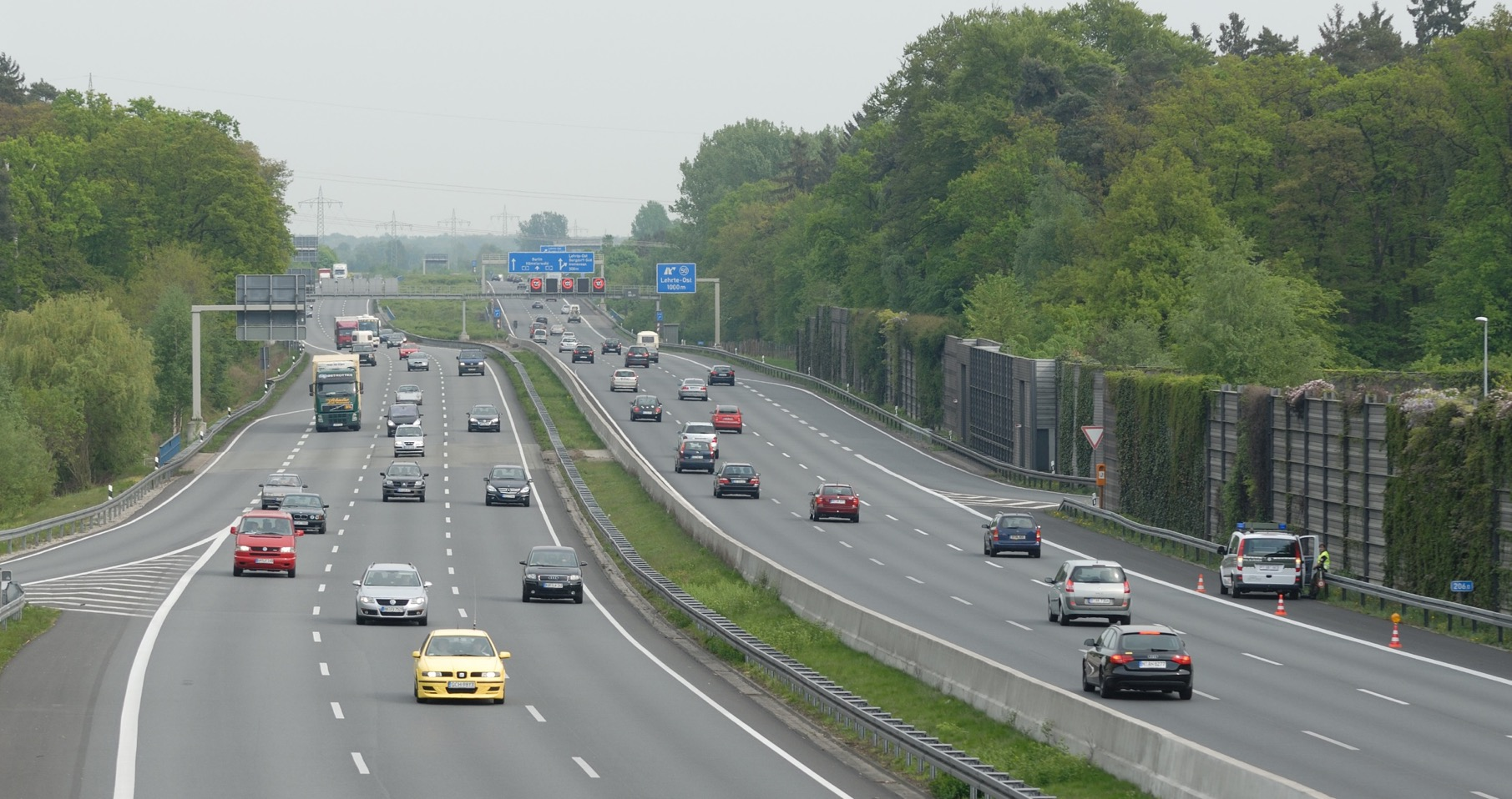
Highway good

Slide 15
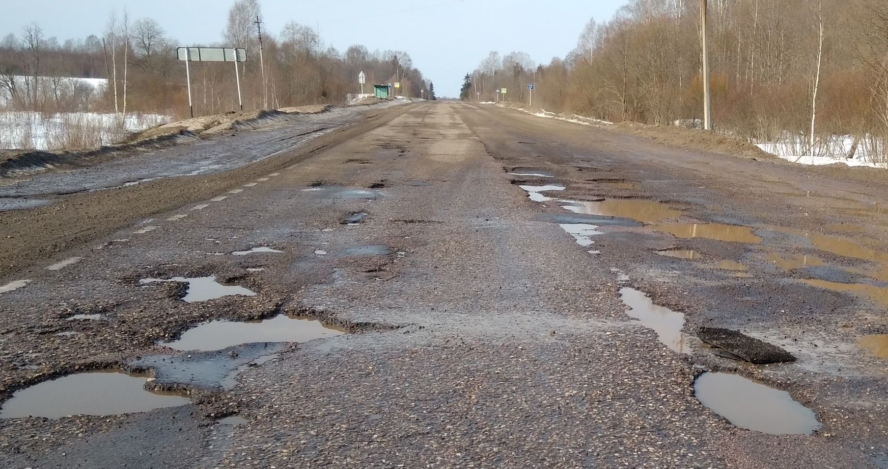
Broken road bad

Slide 16
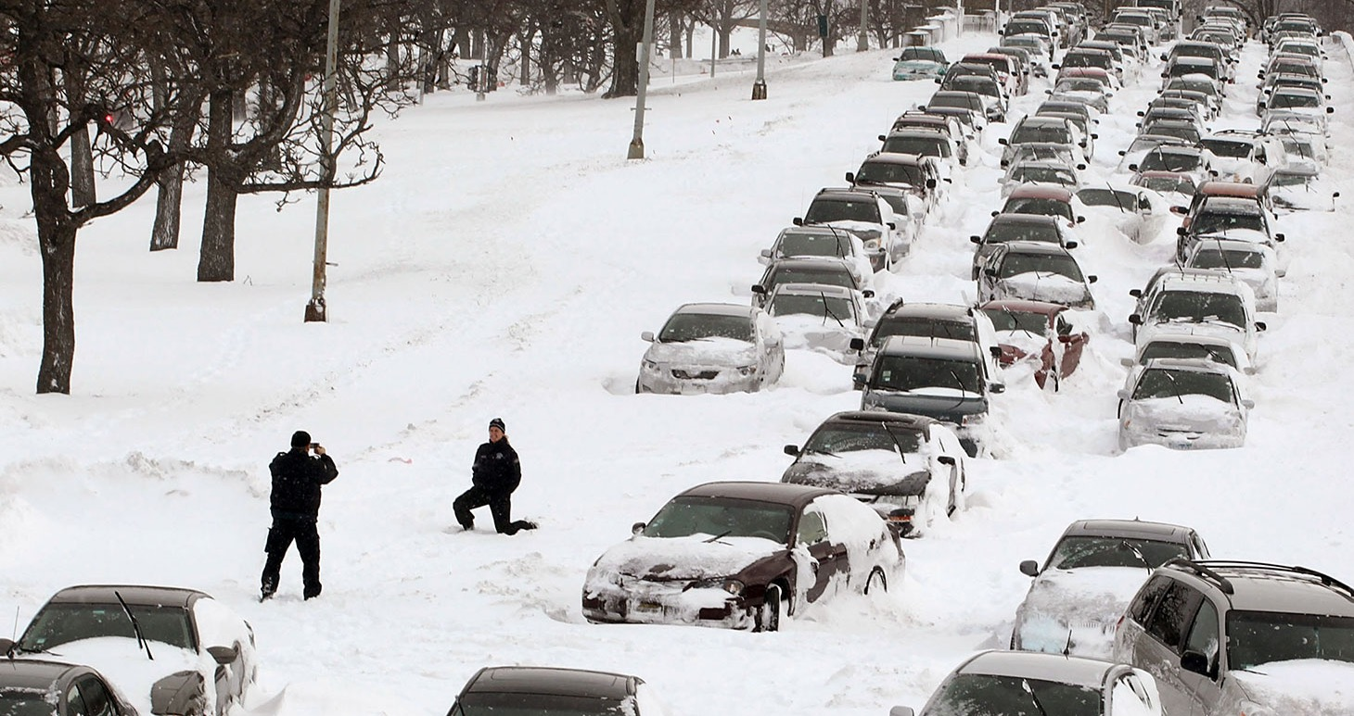
Thunder storm bad

Slide 17
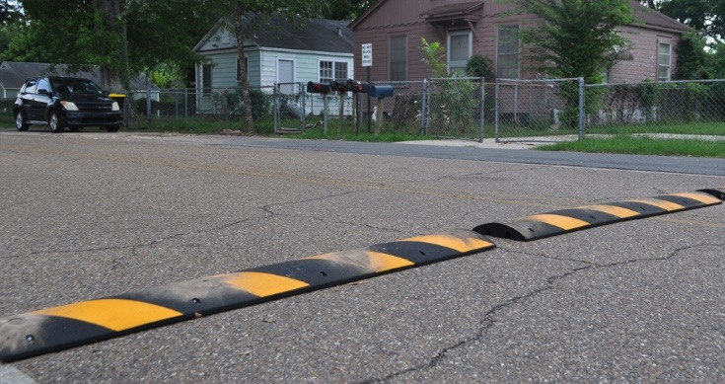
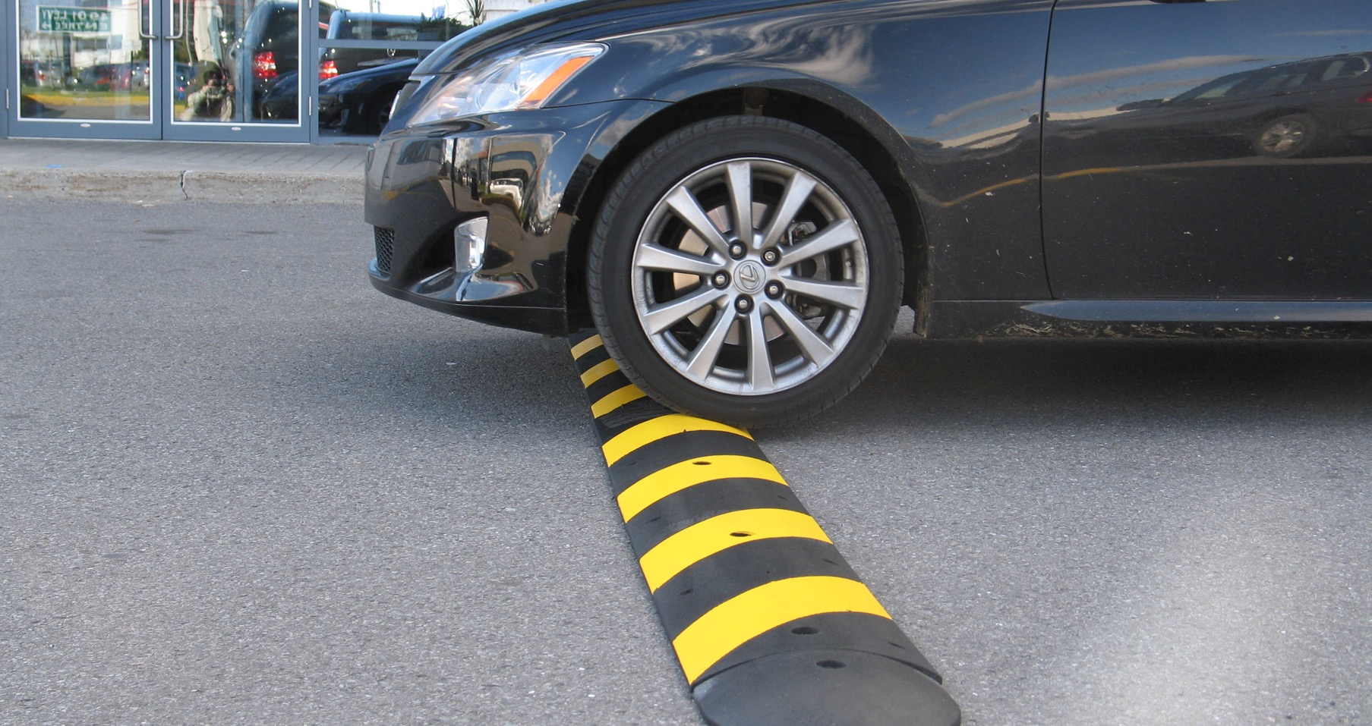
Thunder storm bad

Slide 18
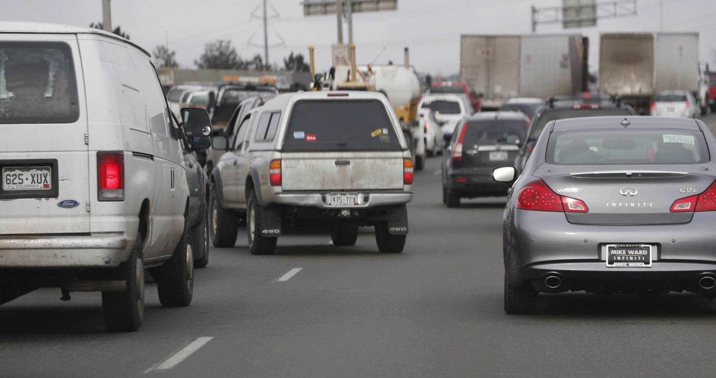
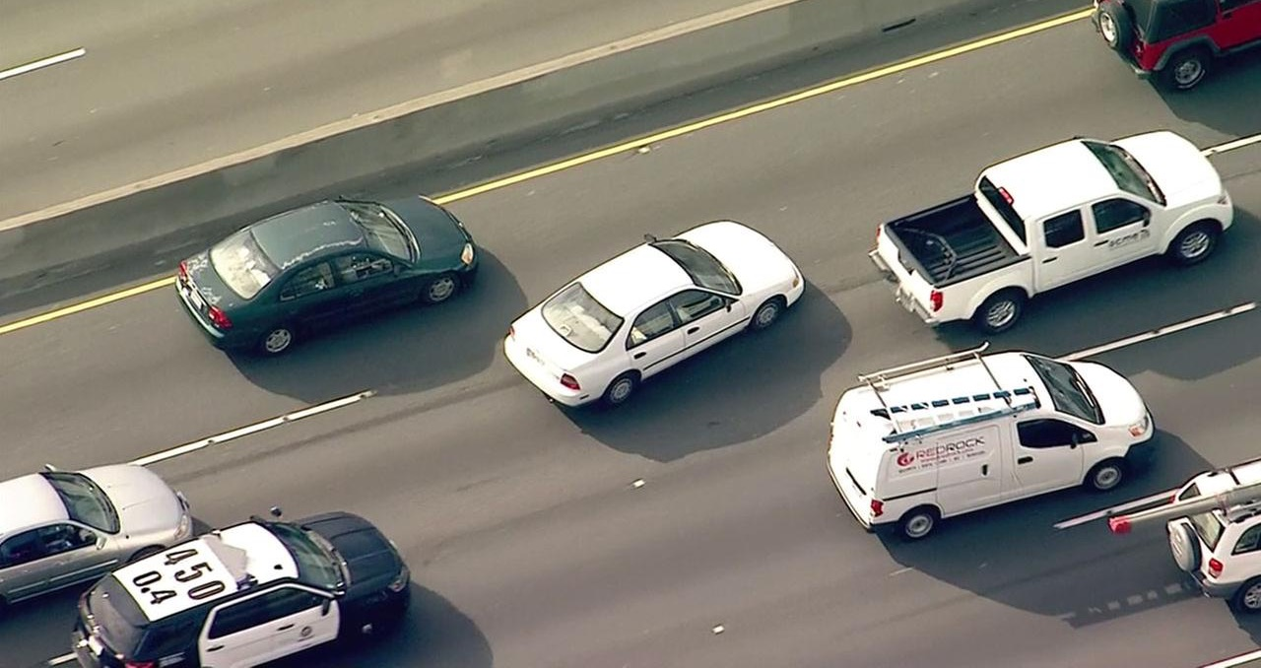
Taxi bad

Slide 19
Crowdsourced map

Slide 20
Personalized learning
Small number of observations
Strong User
Patterns
Computationally
Friendly

Slide 21

Fleet learning
Ton of
Observations
No User
Patterns
Computationally
Complex

Slide 22
ACC Solution
Crowdsourced Edges
Solution idea: Collect data from all drivers and build
a crowdsourced map of road segments, where drivers used ACC. Use this map as a basis for further recommendations
Key notes:
We need to create some filter based of usage frequency
by one and/or several driver, to avoid accidental usages

Slide 23
Initial solution: Layer 1
Data Preprocessing:
Journey creation
Map matching
ACC usage segments
detection
Data Crowdsourcing:
Combining data
from different users
Smart Filtering:
Drop occasionally
ACC engagement

Slide 24
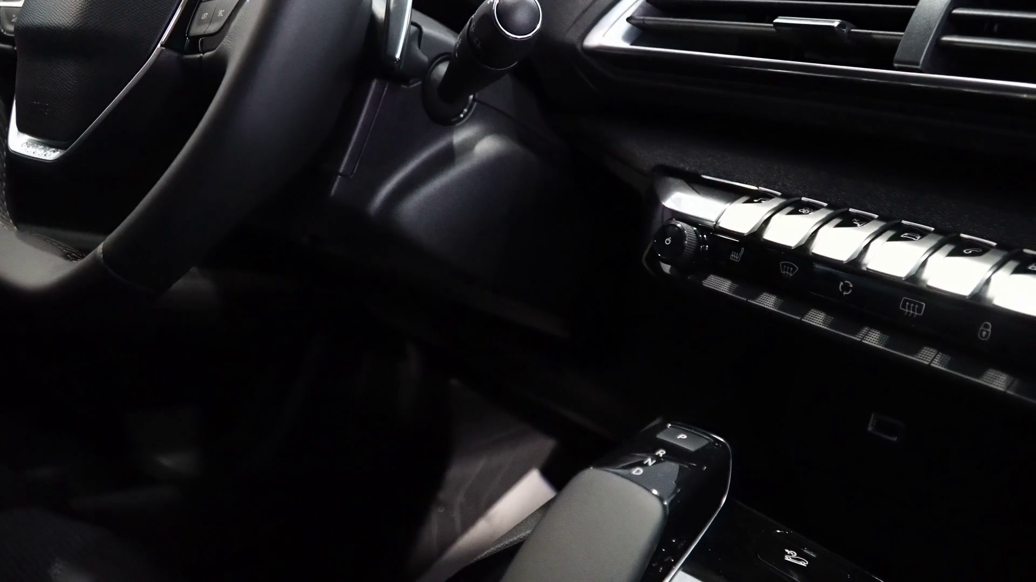
Personalized
Context

Slide 25
Advanced ACC: Solution
Crowdsourced Edges
Solution idea: Drivers don’t always use ACC (on the same
road segment). The idea of L2 is to define the context influence into ACC usage. Under the context we will use set of features, extracted from available signals during short time period
(e.g. 15sec.) before each observation
Key notes:
The feature vector structure and it’s influence into the result
will be defined by ML model
Personalized Context

Slide 26


Raw data
Driving signals
Time/Space
Passengers
Weather
Traffic
Road characteristics

Slide 27

Issues with data
1
Signals are duplicated
Leave the first signal in the sequence
of the same.
2
Signals are missed
    Signals such as brakes, ACC turning on/off, ACC resuming often are missed.
3
Small variety of signals
We don’t have signals such as traffic and temperature what are extremely useful.
4
Missed trip areas
Looks like the start and the end
of trip are cutted.

Slide 28

Issues with data
1
Signals are duplicated
We can get several identical signal during small period of time.
2
Signals are missed
    Use for analysis only signal we trust.
3
Small variety of signals
Trying to define traffic level based
on vehicle speed.
4
Missed trip areas
Filter trips where no history before ACC engagement.

Slide 29
Features
Weather
Traffic
Passengers

Slide 30
Features
Time/Space
Day of week
Time of day
Weekend
Road characteristics
Road type
Speed limit
Steering Wheel
STD 5/10/15 value sec till edges
MIN 5/10/15 value sec till edges
MAX 5/10/15 value sec till edges
MEAN 5/10/15 value sec till edges
Speed
STD value 5/10/15 sec till edges
MIN value 5/10/15 sec till edges
MAX value 5/10/15 sec till edges
MEAN value 5/10/15 sec till edges

Slide 31
Features
Speed
STD value 5/10/15 sec till edges
MIN value 5/10/15 sec till edges
MAX value 5/10/15 sec till edges
MEAN value 5/10/15 sec till edges
number of stops 5/10/15 sec till edges
number deceleration 5/10/15 sec till edges
number acceleration 5/10/15 sec till edges
Road characteristics
Road type
Speed limit
Traffic

Slide 32
Feature selection
Drivers have specific preferences
and not all features
are valuable for everyone.

Slide 33
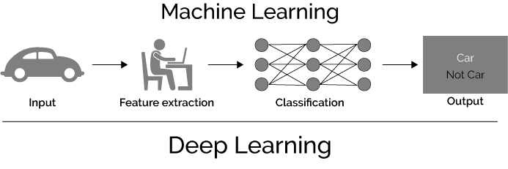
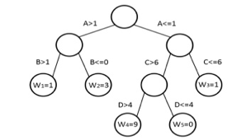
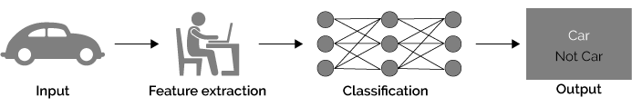

Automatic feature generation
ACC
Expertly-defined features
ACC
Auto feature extraction

Slide 34
Final flow
Journey signals:
Speed
Speed Limits
Type of work
Steering wheel angles
Timestamps
Time zones
ACC usage segments
User inputs
Expert-Based features extractor
ML model trained on ACC ACTIVE state
Feature importance
for each driver
ML model trained on ACC ON state
ML Smart Feature Extractor

Slide 35
Summary
Designed and validated on real fleet data.
Crowdsourced solution improved by personalize patterns knowledge.
The system can be used for automatic switching-on and resuming ACC for car with different autonomy levels.

Slide 36
Thanks for your attention!
Please ask your questions!

Slide 37
nsheremeta@cloudmade.com
olena.kasianenko@cloudmade.com

