Slide 1
Closing the Loop: A scalable ensemble reinforcement learning algorithm for the Internet of Things
Brandon Rohrer
Senior Data Scientist

Slide 2
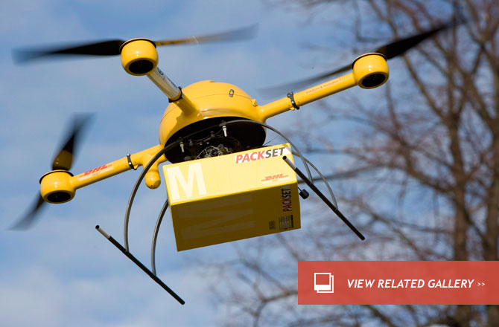
Applications and Markets
Buildings and facilities
Power (HVAC/lighting)
Security, surveillance, alarms
Advertisement and marketing
Interactive displays and kiosks
Robotics
Drone inspections
Entertainment

Slide 3
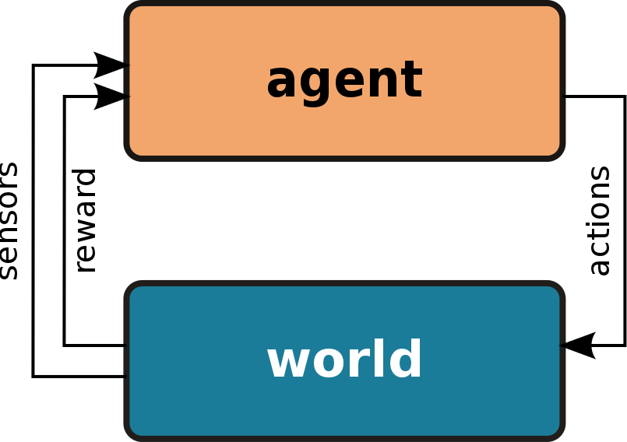
Reinforcement Learning and IoT
Learns decisions, not classifications or predictions.
Needs no data to start.
Doesn’t require ongoing human participation.

Slide 4
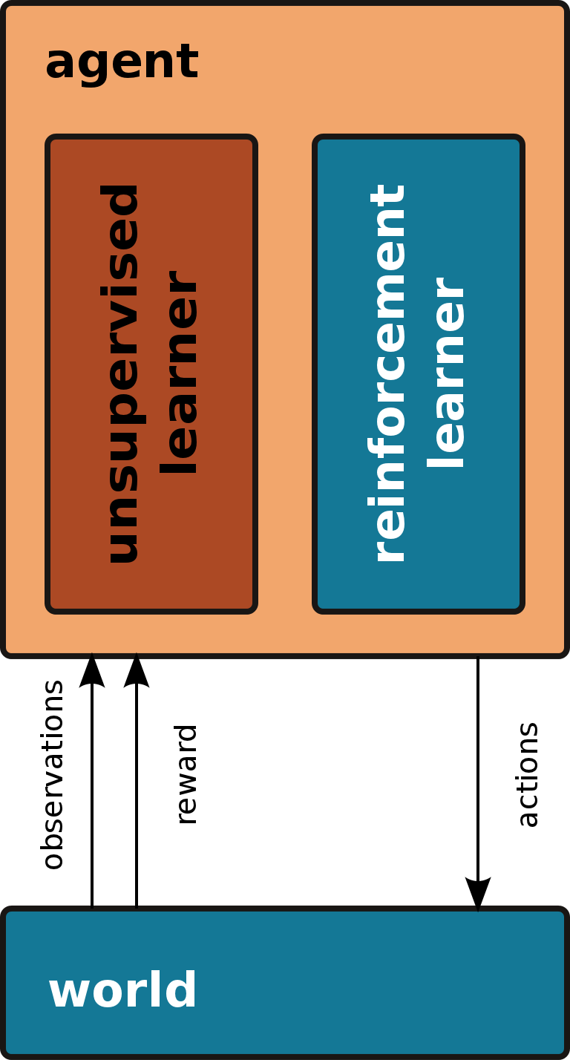
BECCA
Hybrid unsupervised / reinforcement learning algorithm
Hierarchical
Dynamic
Sparse
Incremental
GitHub
https://github.com/brohrer/becca/

Slide 5
RL Algorithm
Update a reward estimate for each feature-action pair.
Based on observed reward.
Choose the action likely to result in the highest reward.
Based on current features.
Use ‘curiosity’ to explore.
Assign additional reward to feature-action pairs where the action
is taken only rarely or
hasn’t been taken in a long time

Slide 6
Example
One-dimensional grid world
Nine states
Circular
3 is rewarded
8 is punished
Nine actions
8 is no action
Random jumps
On 10% of time steps
8 7 6 5 4 3 2 1 0
0 1 2 3 4 5 6 7 8

Slide 7
Update reward
For each feature-action pair, step the old estimate toward the observed value.
Step estimates only a fraction of the way.
Leave other feature-action pairs unchanged.
Algorithm is incremental.
For steps of 1/10 it converges to within 1% of steady state after 42 iterations.
8 7 6 5 4 3 2 1 0
0 1 2 3 4 5 6 7 8

Slide 8
Update reward
Q_indices = state * action.T
delta_return = return – expected_return
rate = 1./10
Q += Q_indices * delta_return * rate

Slide 9
Choose an action
Use active features to make a weighted average across actions.
Choose the action with the highest average reward and curiosity.
8 7 6 5 4 3 2 1 0
0 1 2 3 4 5 6 7 8

Slide 10
Choose an action
return_by_action = weighted_average(
return, weights=feature_activities)
action = argmax(return_by_action)

Slide 11
Choose an action with curiosity
return_by_action = weighted_average(
return, weights=feature_activities)
count += Q_indices
curiosity = 1 / (1 + k * (1. + count))
curiosity_by_action = weighted_average(
curiosity, weights=state)
action = argmax(return_by_action + curiosity_by_action)

Slide 12
Computation
Quadratic complexity
$$O(n_{states}∗n_{actions})$$
Parallelizable
No interaction between states
Acts as an ensemble
Distributable
8 7 6 5 4 3 2 1 0
0 1 2 3 4 5 6 7 8

Slide 13
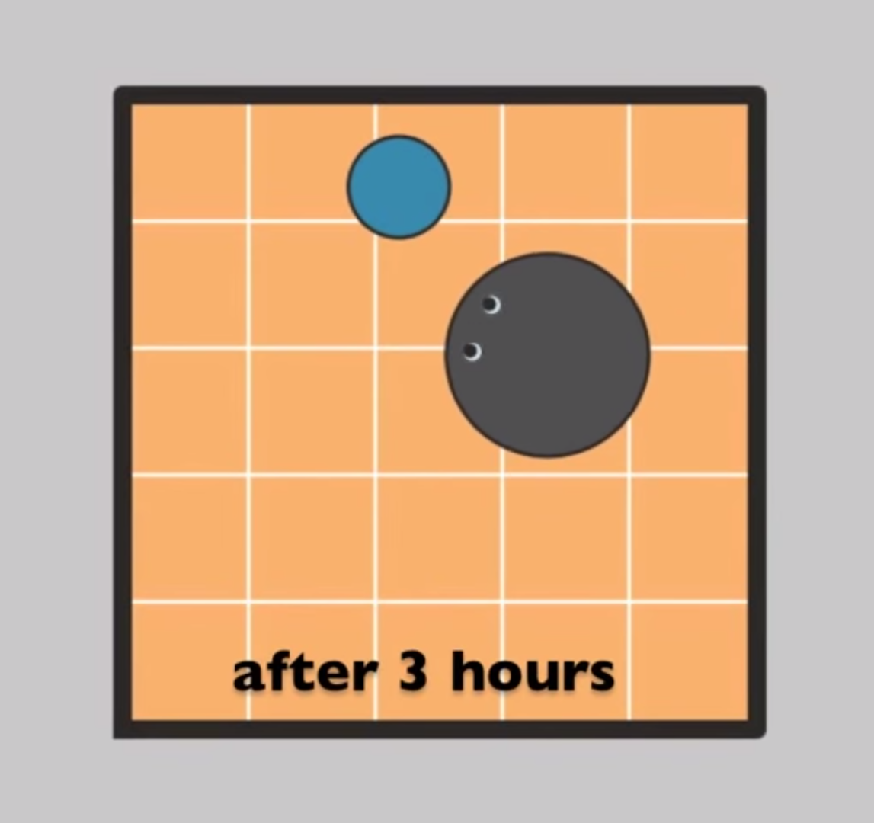
Demonstration Rixel the Robot learns to chase a ball https://youtu.be/uU1_13c6umo

Slide 14
Closing the Loop
Enable incremental algorithms.
Ongoing training.
Constant adaptation.
Integrate cloud machine learning with sensors and actions.
Human isn’t necessarily in the loop.
Number of requests to Azure aren’t limited by human response time.

